Slide 1
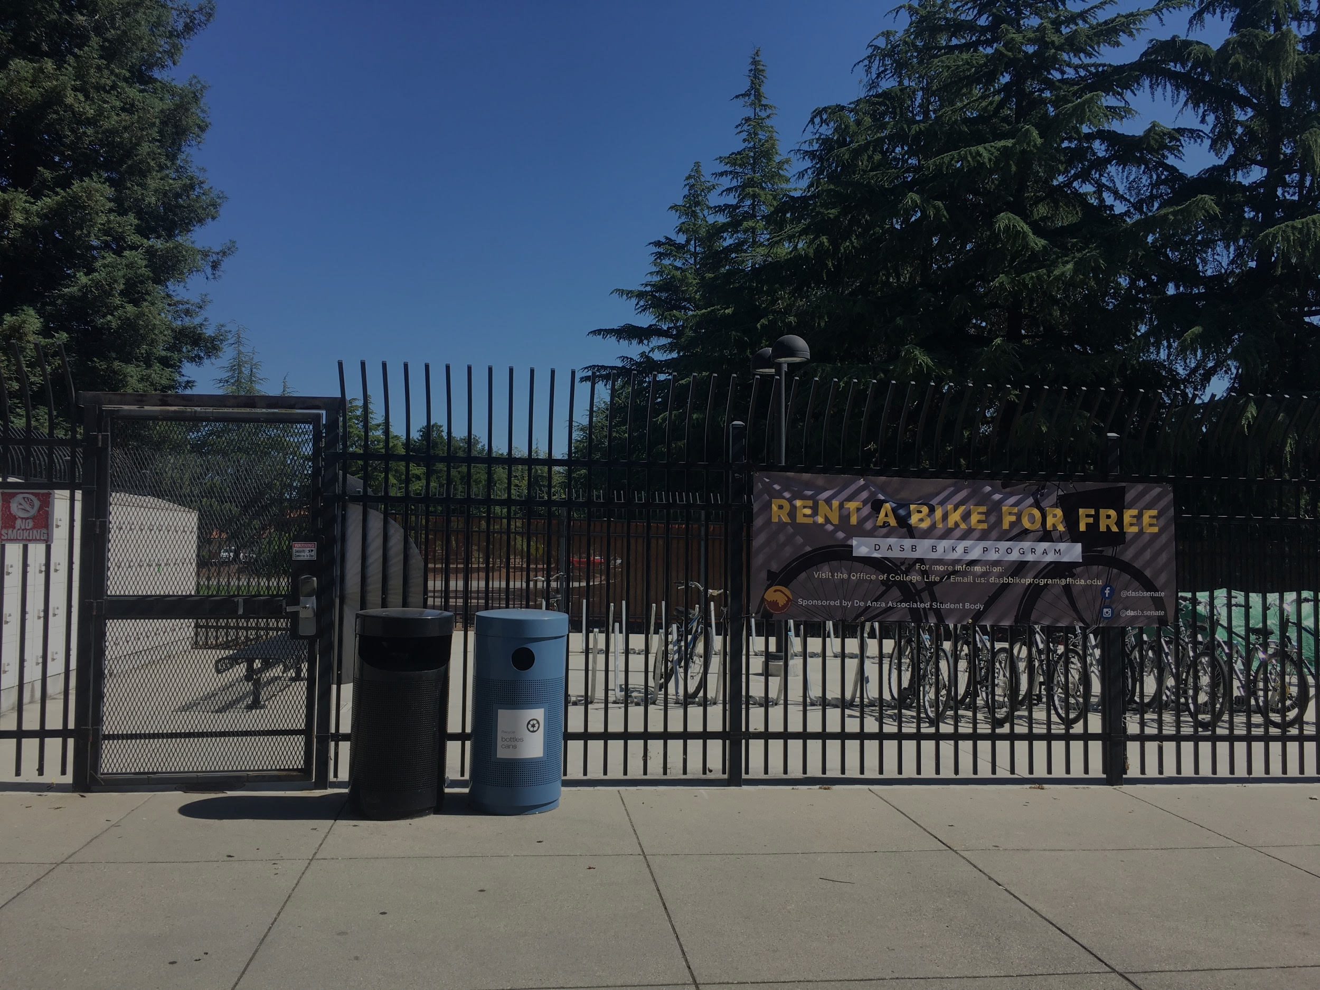
De Anza
Bike Corral Structure
Casey Cosgrove & Steve Hoang
Notes:
Steve is the Chair of the Environmental Sustainability Committee of DASB.
Casey is former DASB Bike Program coordinator.
Working together since Spring quarter to improve the bike program.

Slide 2
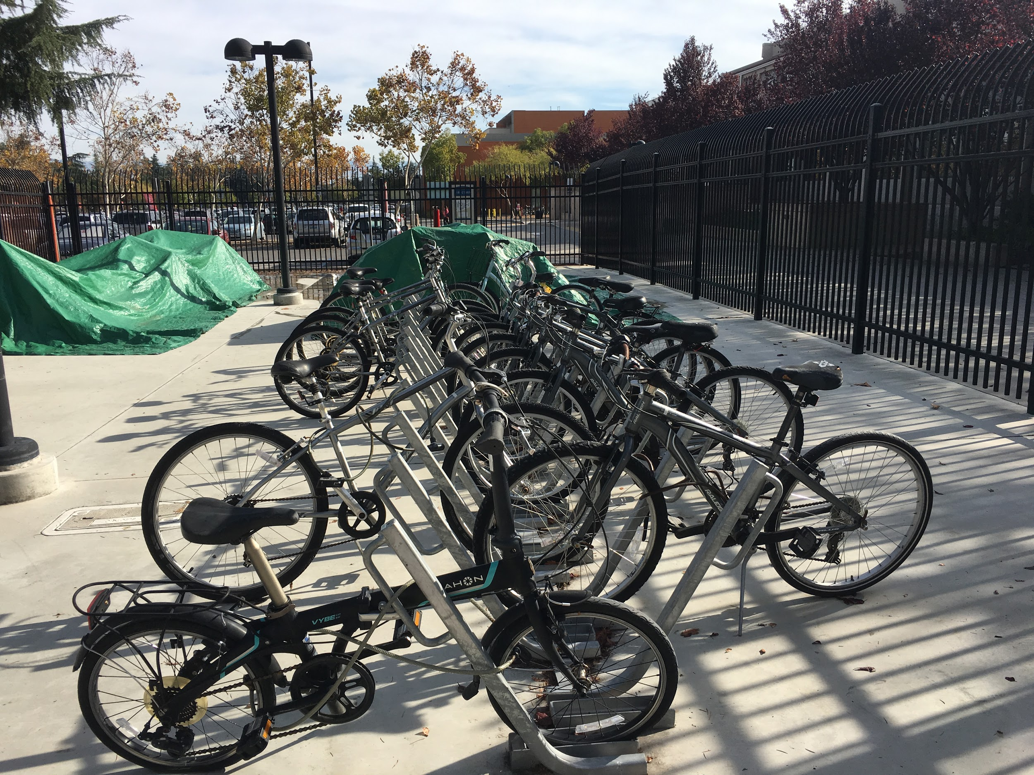
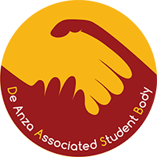
Intro to DASB Bike Program
Two services provided:
Free bike rental
Corral access - Key rental (not free)
How it works:
Requirements
What is provided
Program expanded to meet rising demands.
Notes:
The bike program was established back in 2010-2011 school year by the DASB Environmental Sustainability committee.
Funded via DASB.
Two main services:
Free bike rental
Corral key rental (not free). Open to faculty etc.)
Bike rental service-How it works:
Explain student requirements.
Provides students with, bike, lock, corral key and helmet!
Started with 10 bikes.
Program is popular and well-used. Expanded to 60 bikes.

Slide 3
Program Statistics
2017-2018 Bike check outs: 148
2018-2019 Bike check outs: 105
Notes:
Why so low for 2018-2019: Started the job one week before school started, no training, no manual, coordinate repairs = less checked out bikes.

Slide 4
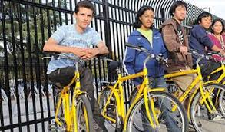
Significance of Bike Program
Meets transportation needs of students.
Part of De Anza’s commitment to sustainability.
In addition to the above...
Aligns with local community vision to promote alternative modes of transportation.
Builds on- and off-campus biking community.
Notes:
Bike program is an essential program because it provides students not only with a way to get to school, but also go out and do errands, go to work, etc. daily necessities.
Helps build biking community on and off campus. Even though we are 4 weeks into the quarter, we received more applications than bikes available.
But because we need to perform repairs on bikes, the number of available bikes is smaller than before.

Slide 5
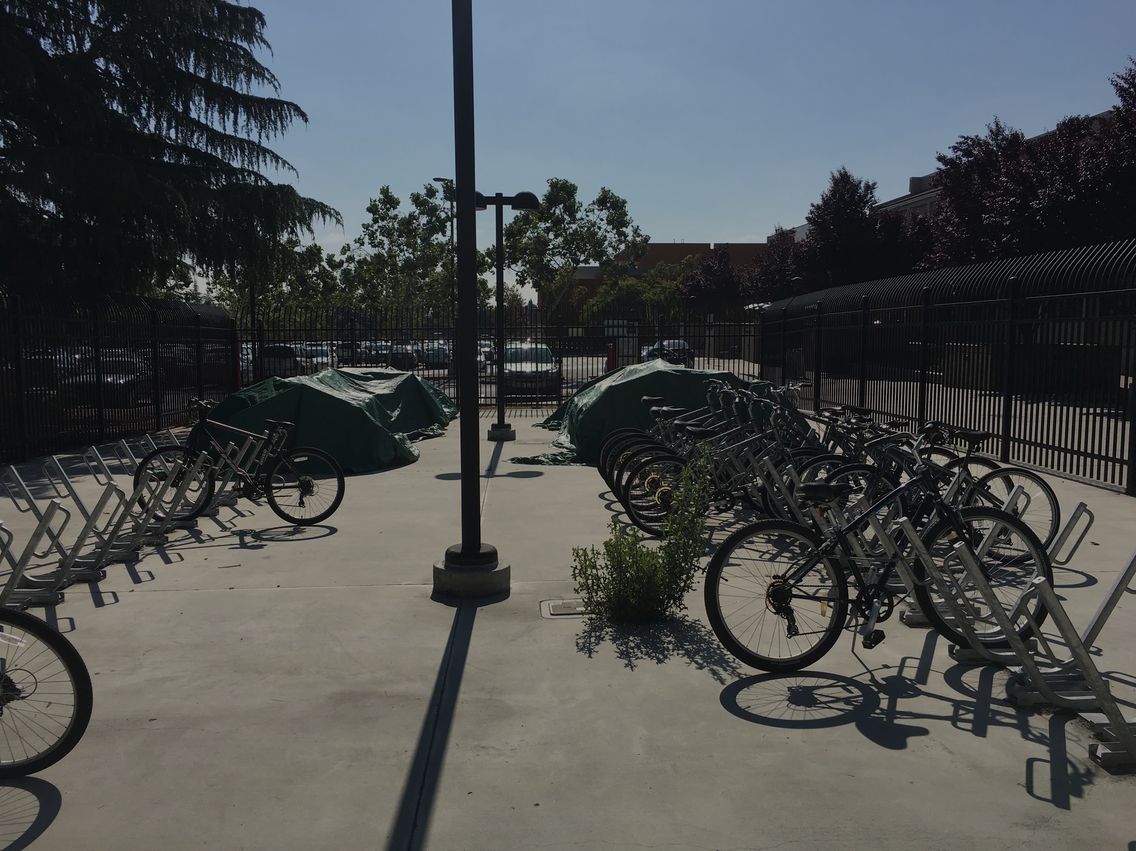
Main Issue Facing the
Bike Program
No structure over the bikes.
Notes:
#1 issue is that we don’t have a structure that protects the bikes from weathering conditions.
Inadequate bikes causes the Bike Program to be inefficient as we cannot serve the student population well.

Slide 6
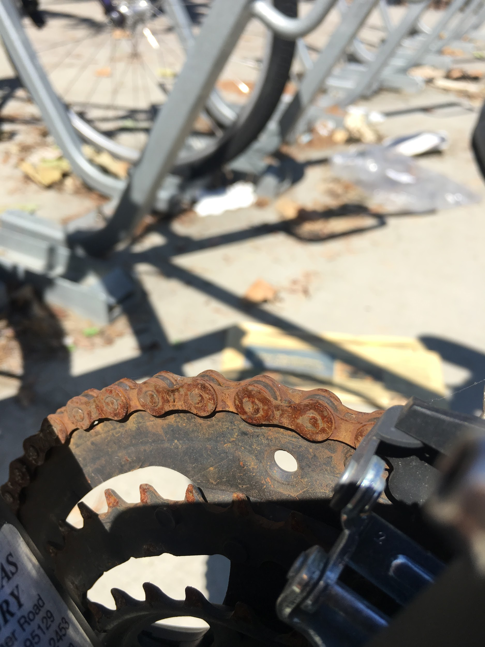
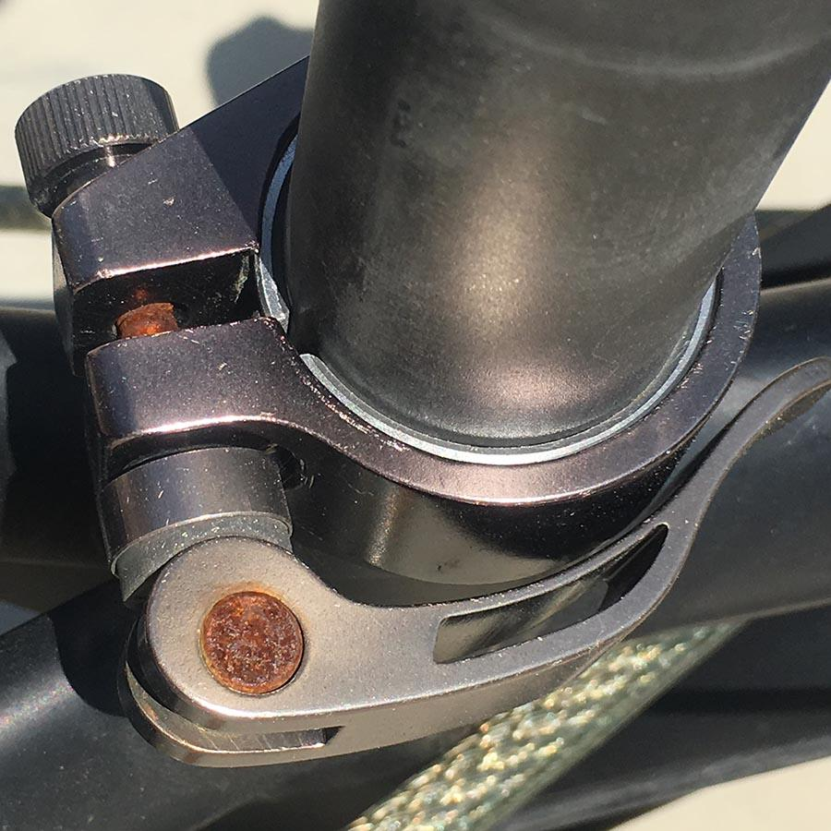
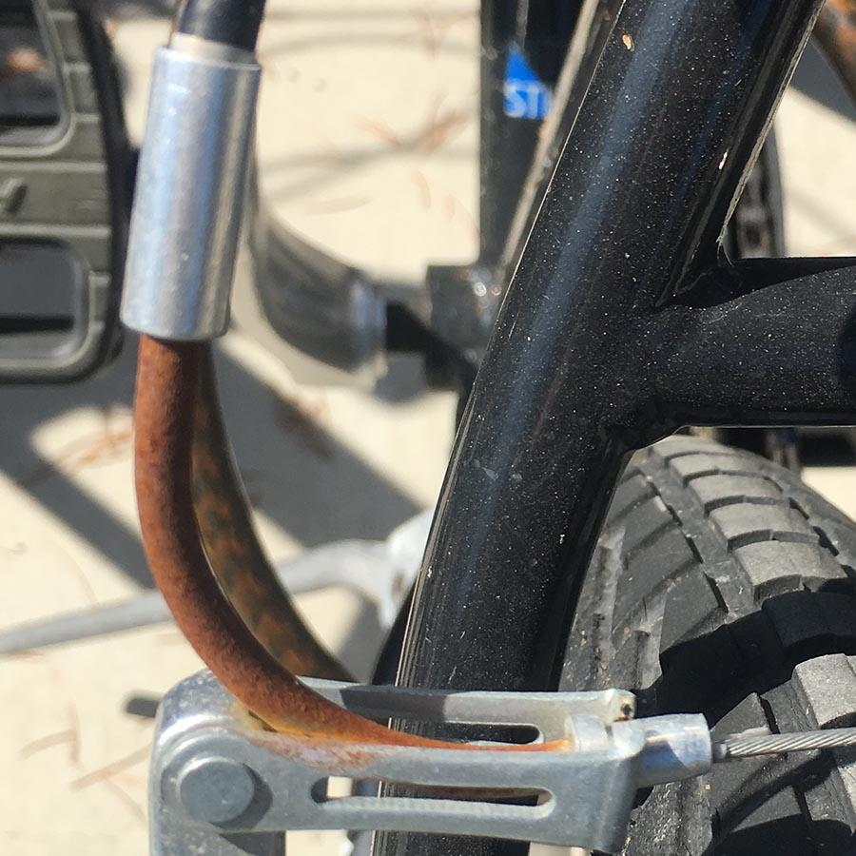
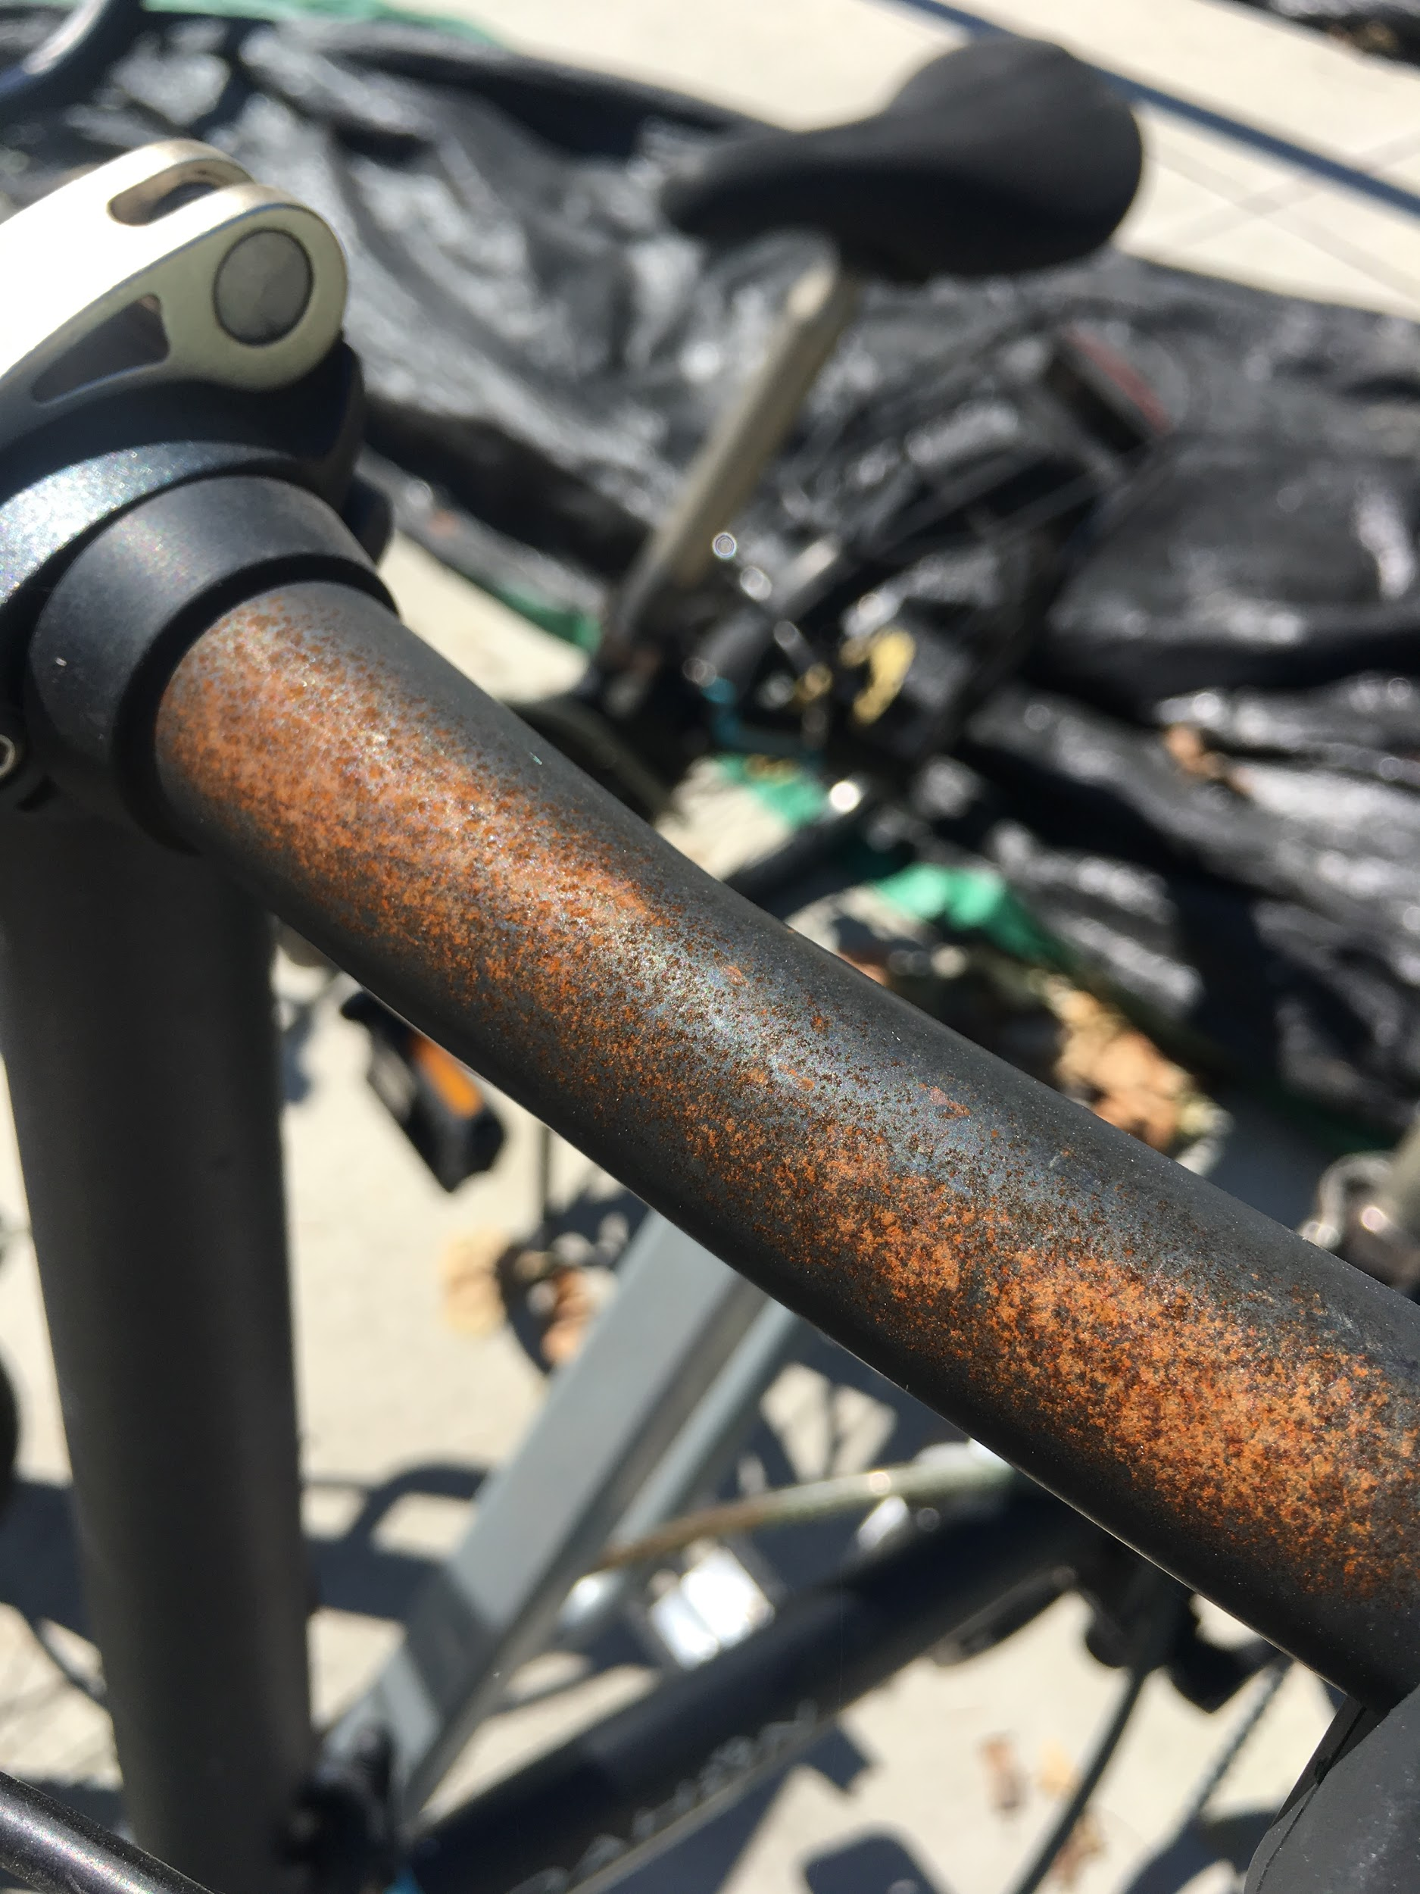
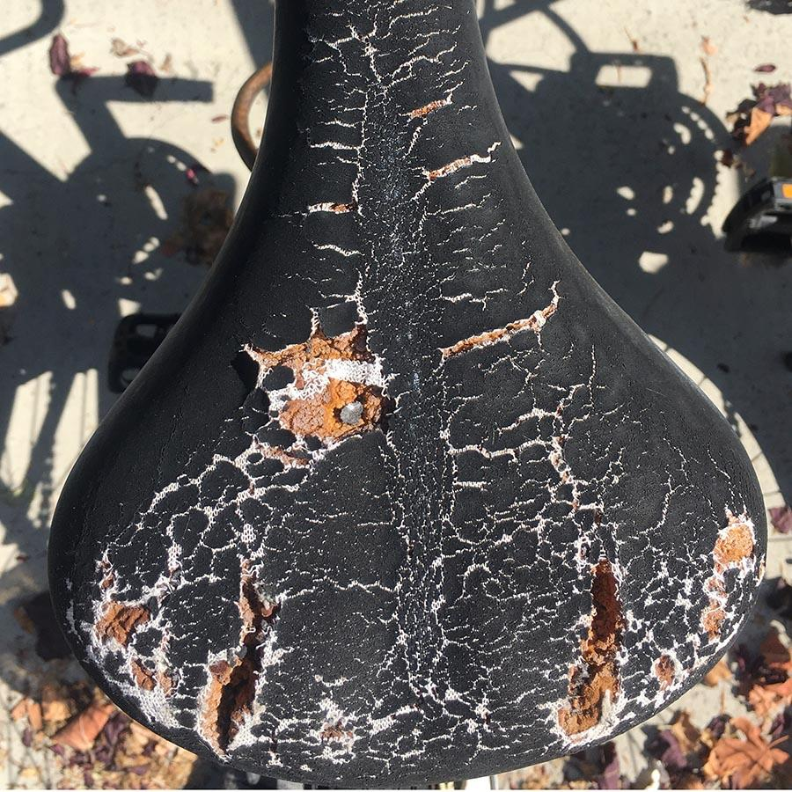
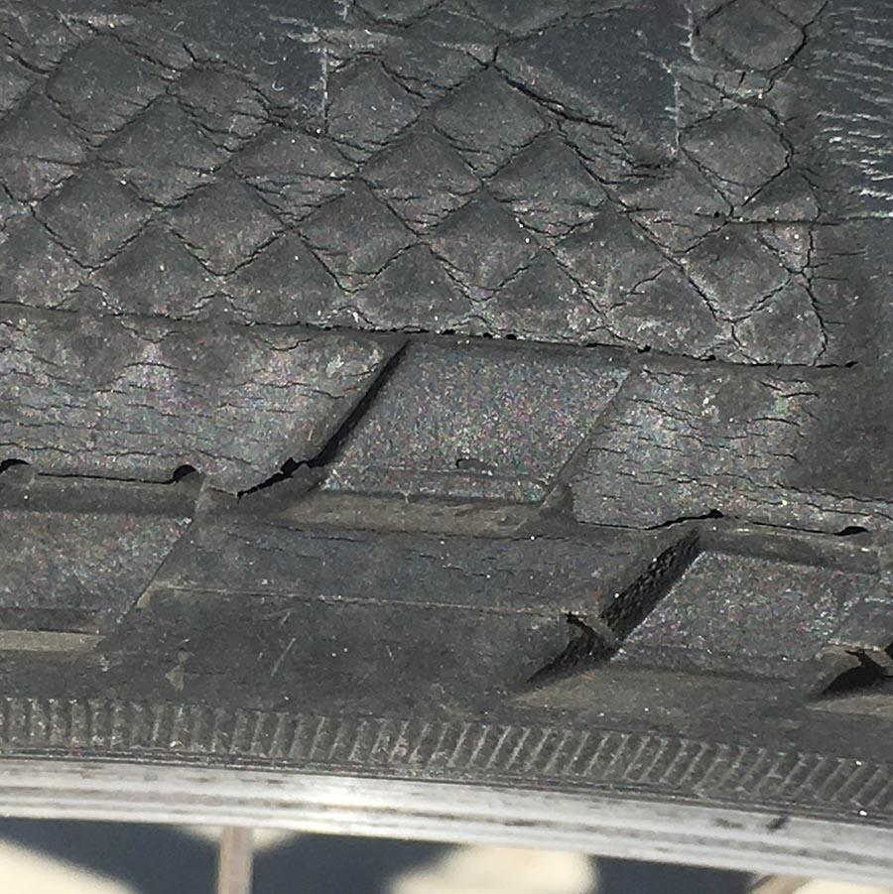
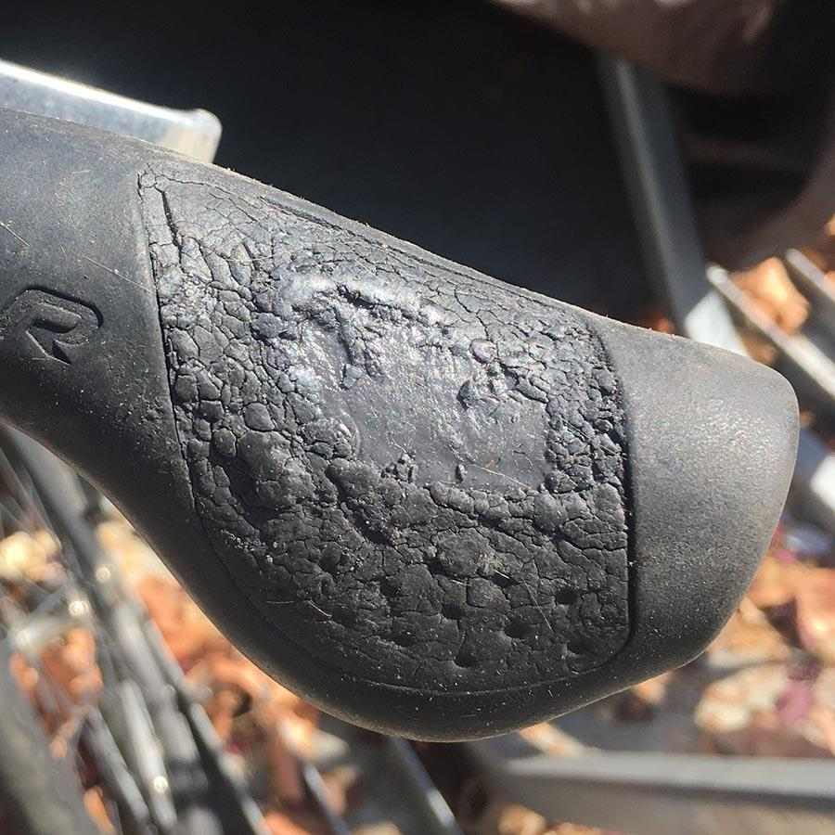
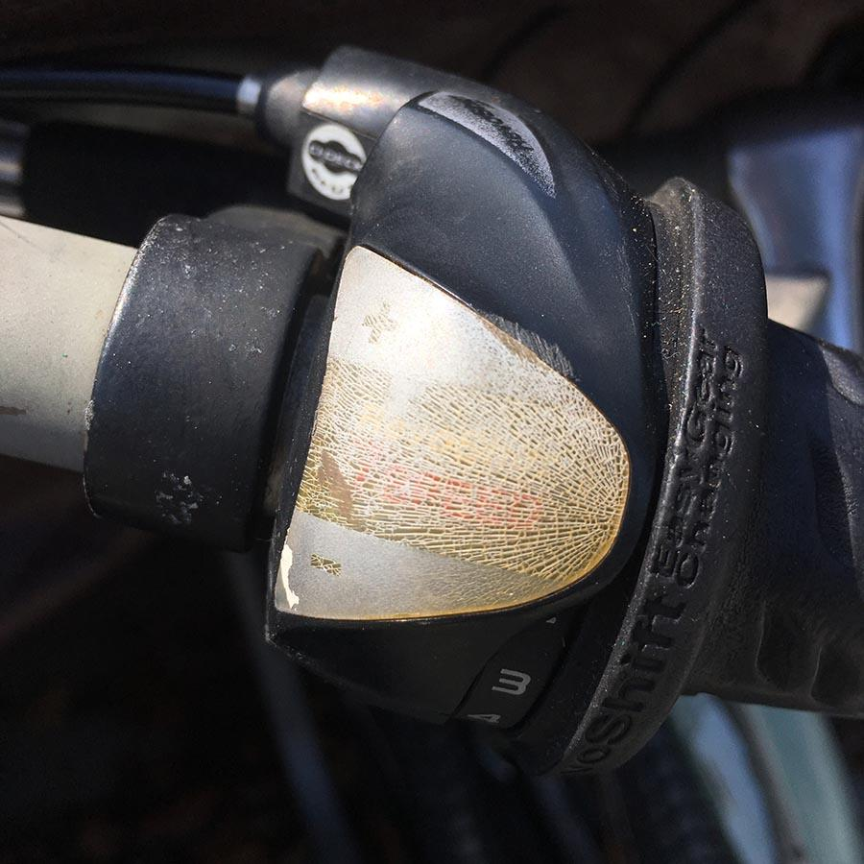
Damage Highlights
Notes:
We took pictures of all of the bikes and wanted to share how bad the conditions of the bikes are without a structure overhead.
Damages can be categorized by exposure to sunlight and moisture.

Slide 7
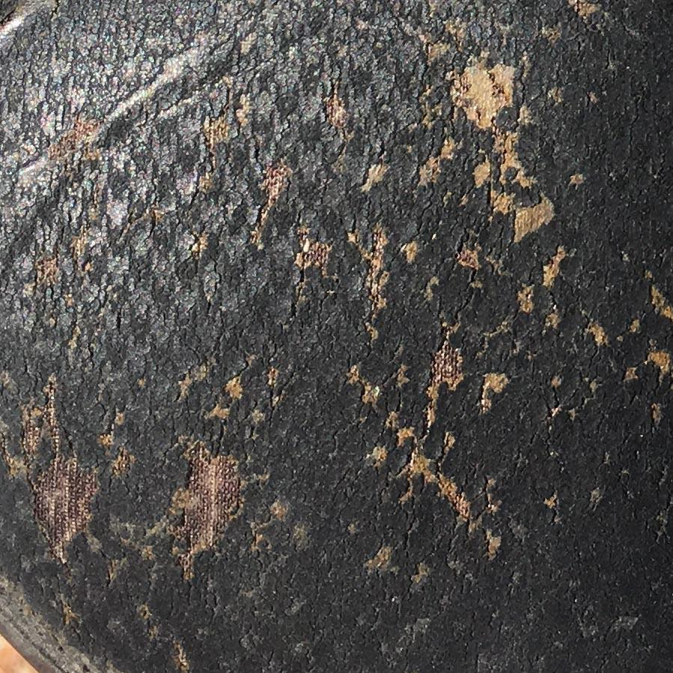
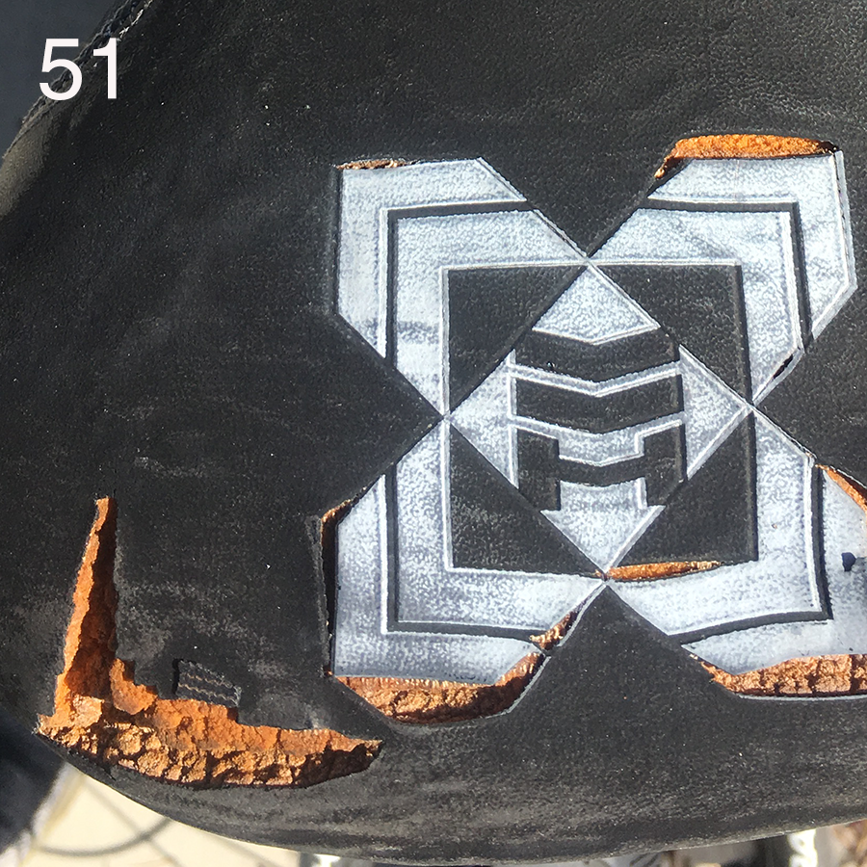
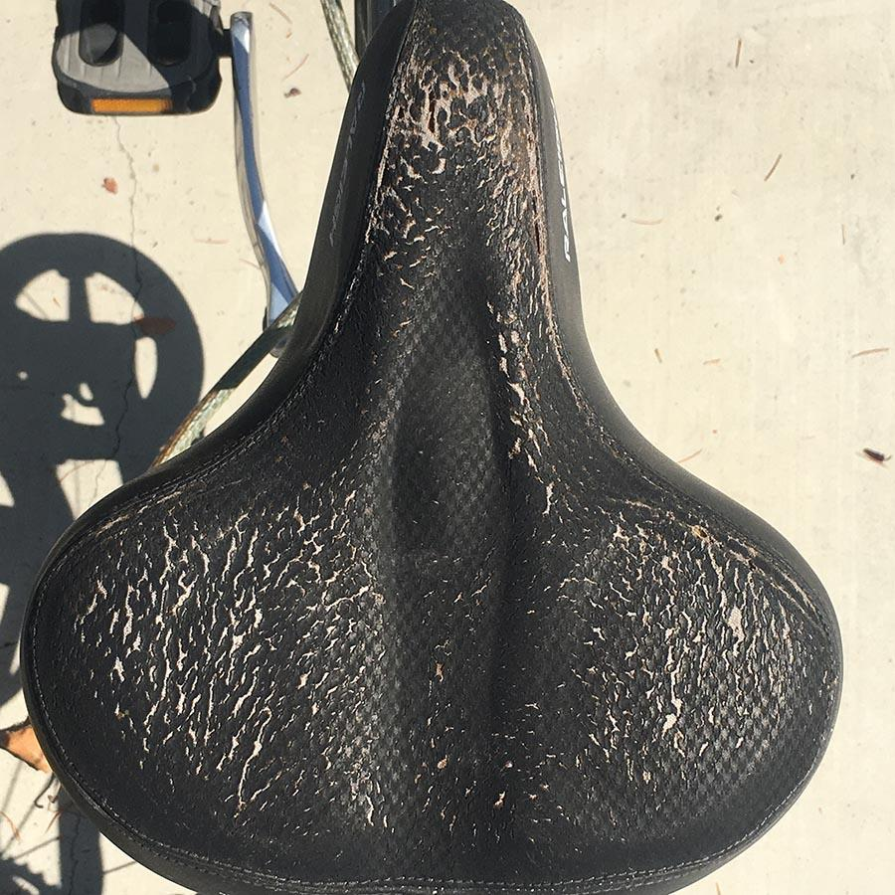
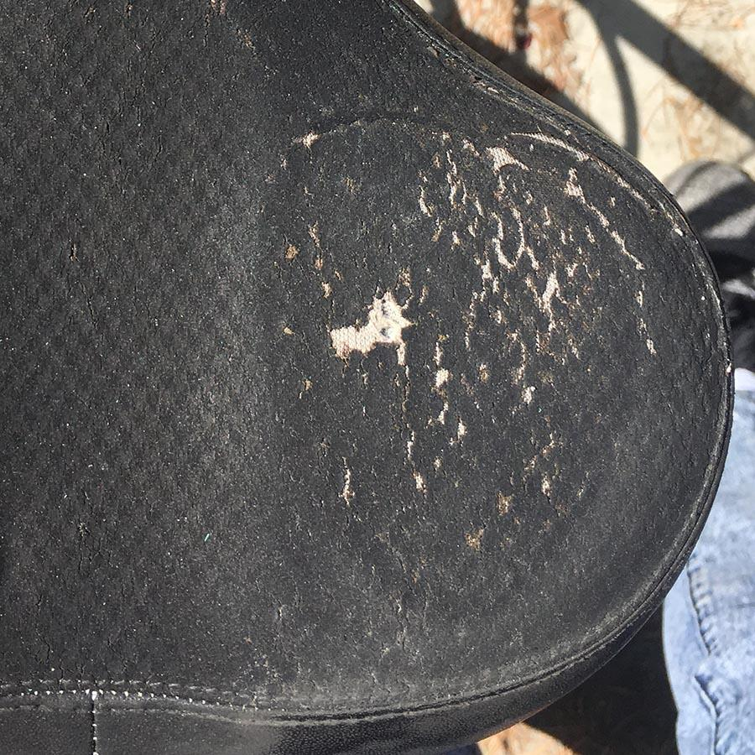
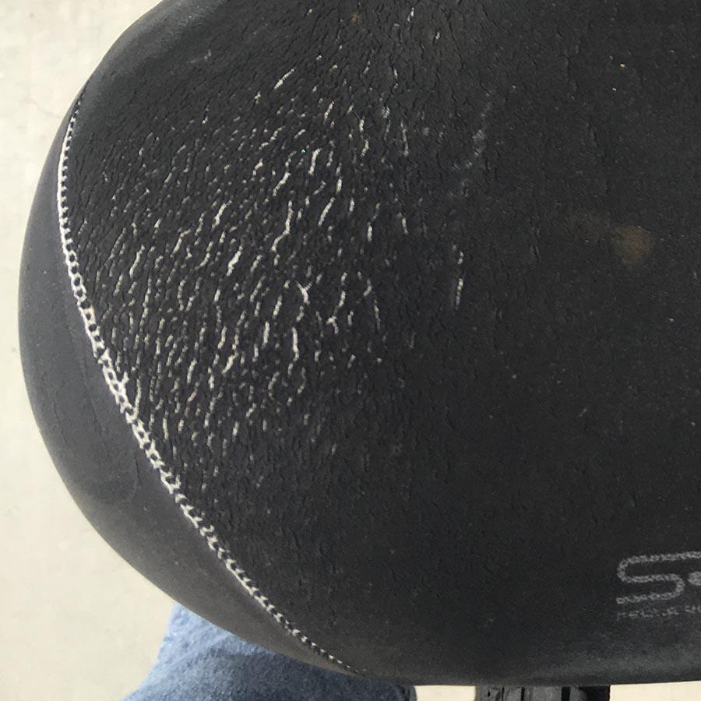
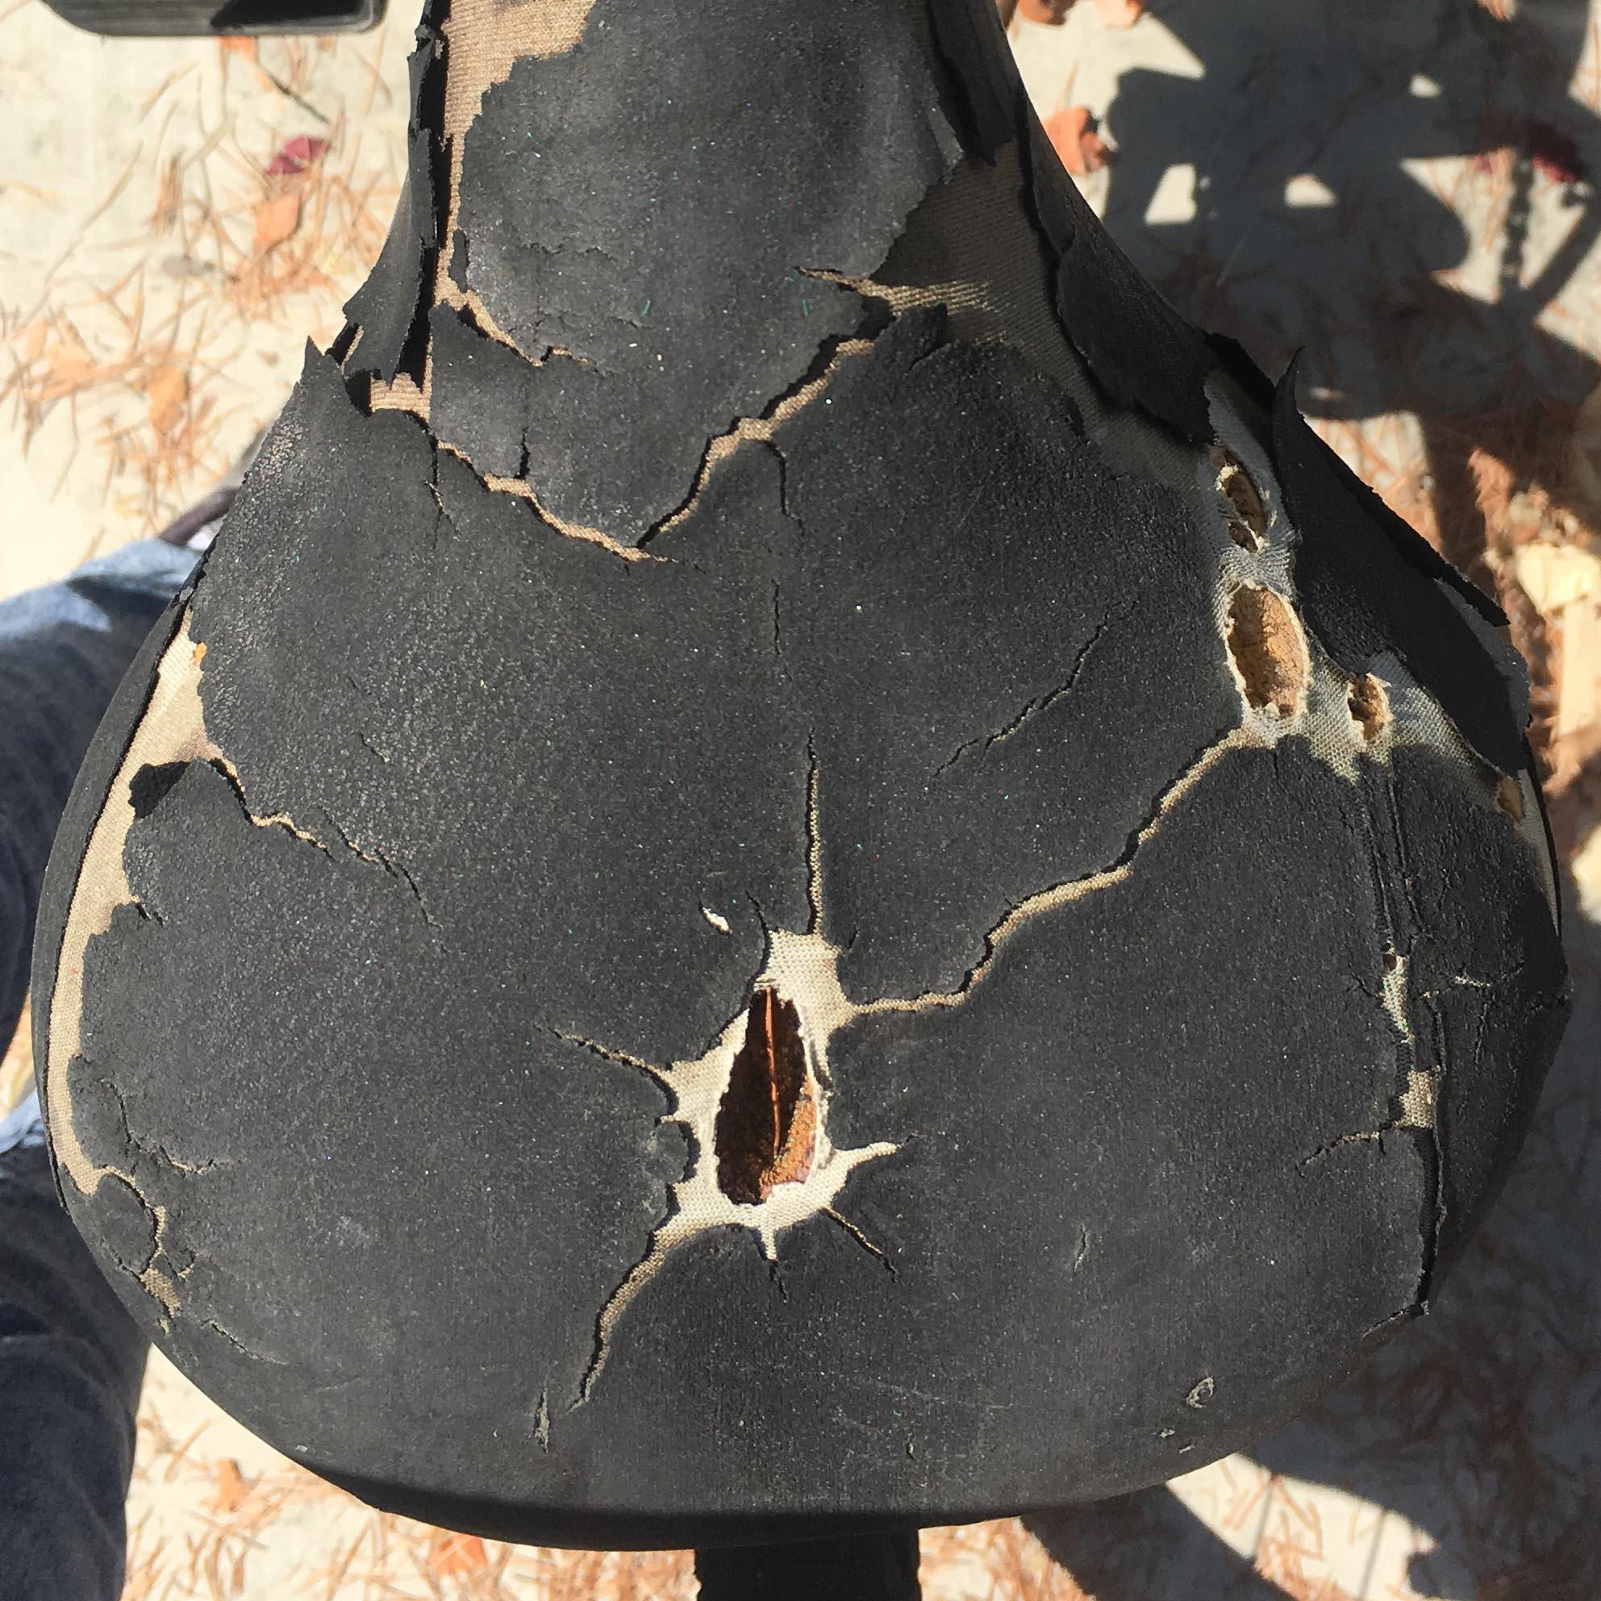
Seats
Bike 85
Bike 51
Bike 53
Bike 59
Bike 84
Bike 69
Bike 74
Bike 81
Notes:
This is what happens to the seats when they are left in direct sunlight.
Exposure to UV light causes polymers to break down, which in turn, causes the material to weaken and tear from light use.

Slide 8
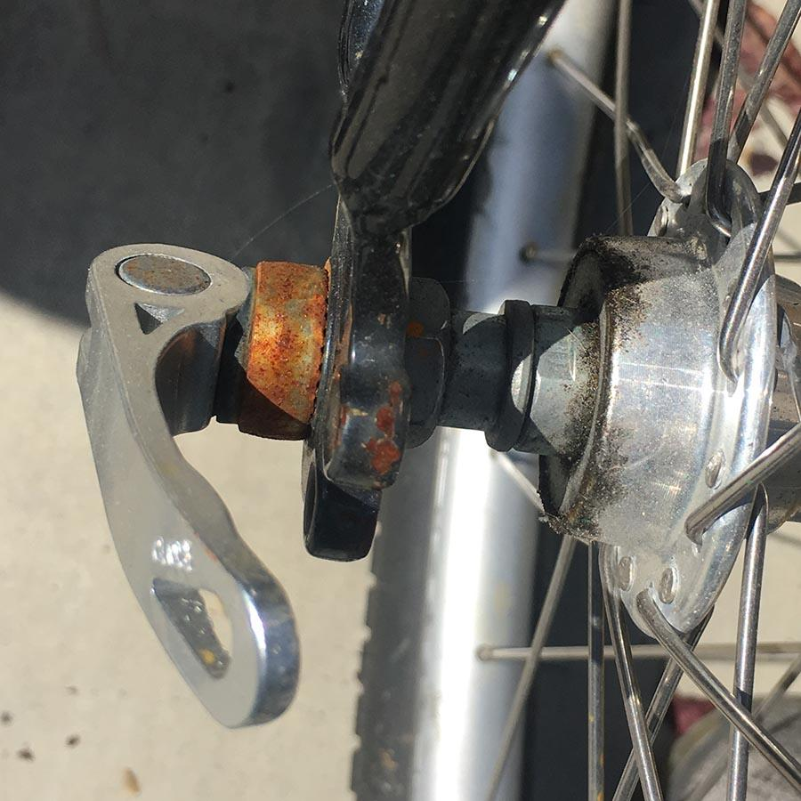
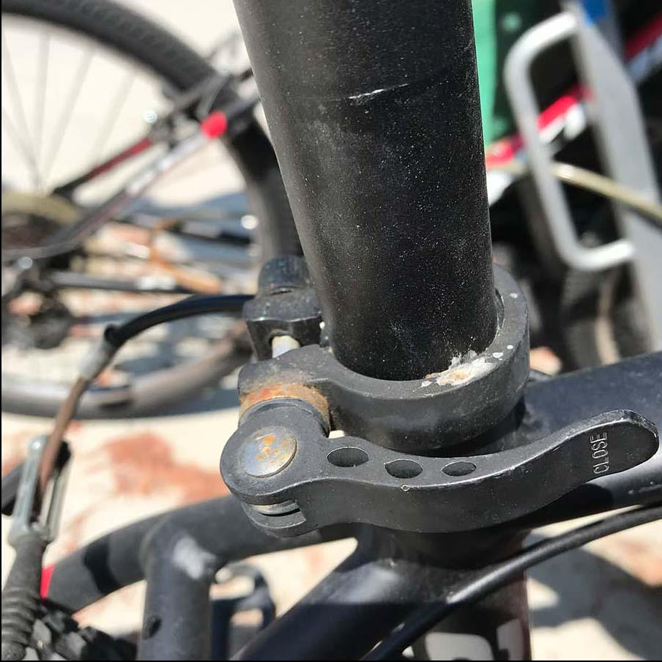
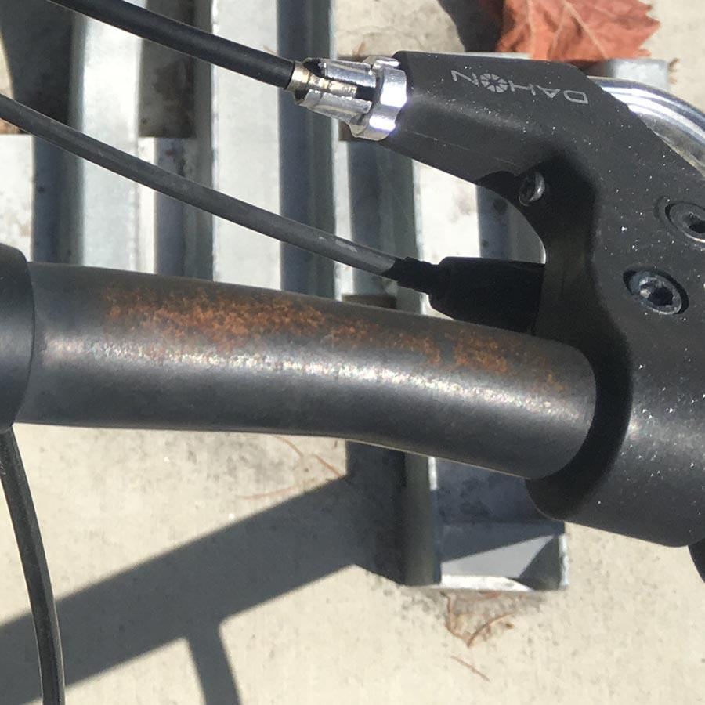
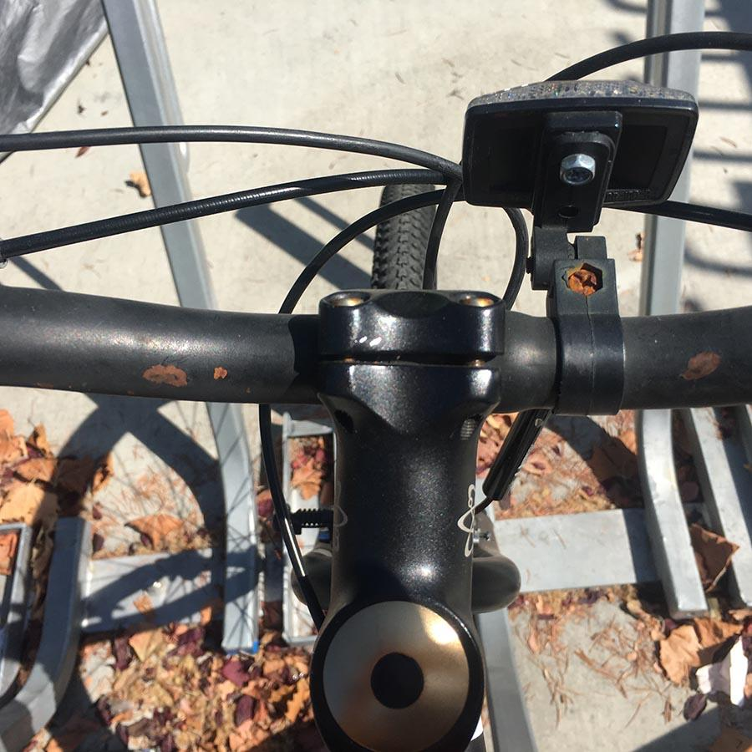
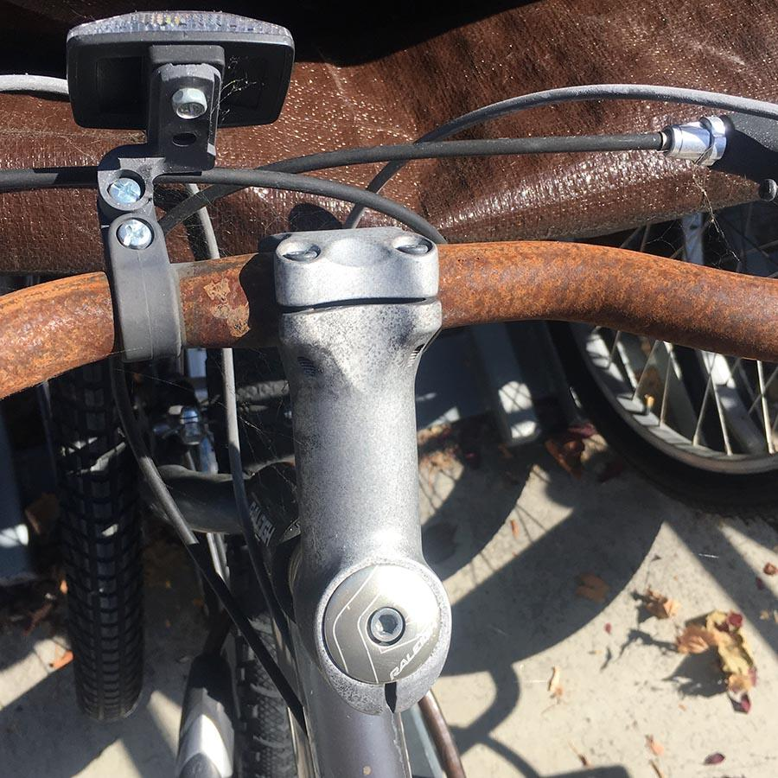
Quick Release
Bike 9
Bike 20
Bike 103
Handlebars
Bike 20
Bike 101
Bike 53
Notes:
Top row: Quick release is what helps secure parts of the bike together.
Rust formed on quick releases pose a safety hazard (cannot secure/disintegrate).
We don’t want to compromise student safety, so we do not check out these bikes. Wait for repairs.
Handlebars also develop rust. Will discuss later how that happens.

Slide 9
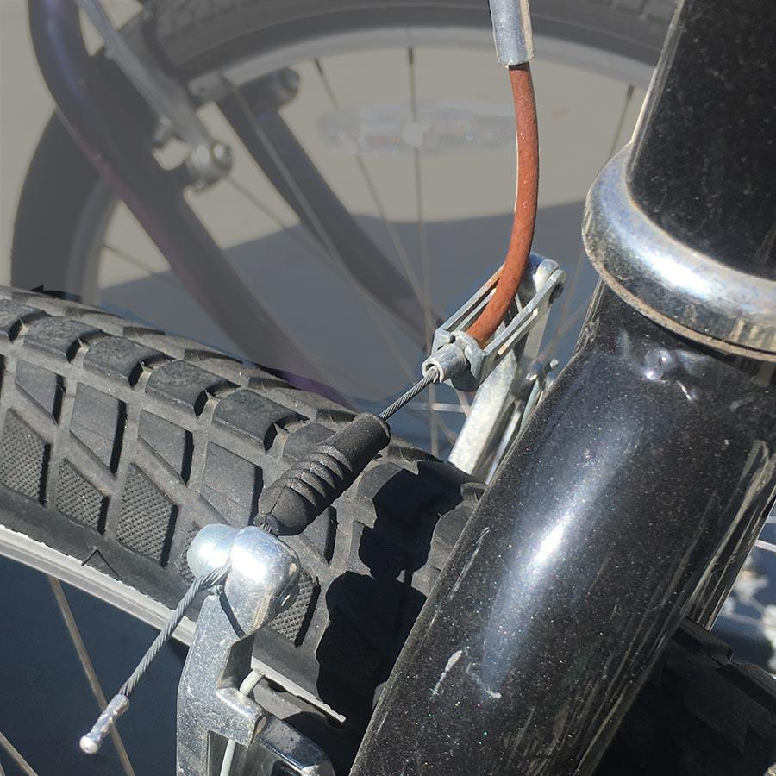
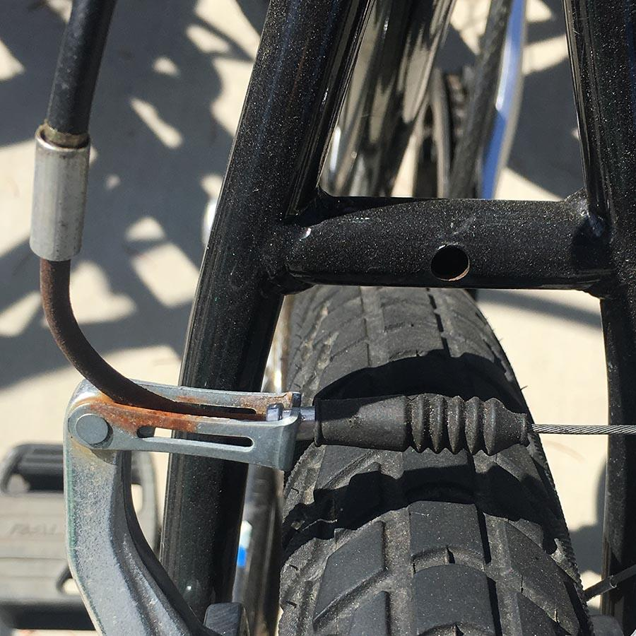
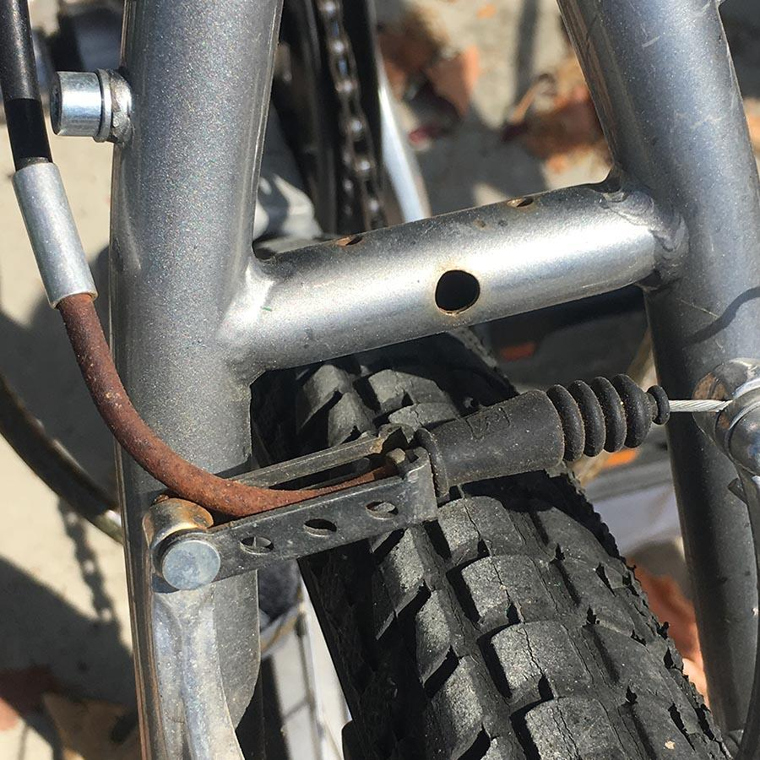
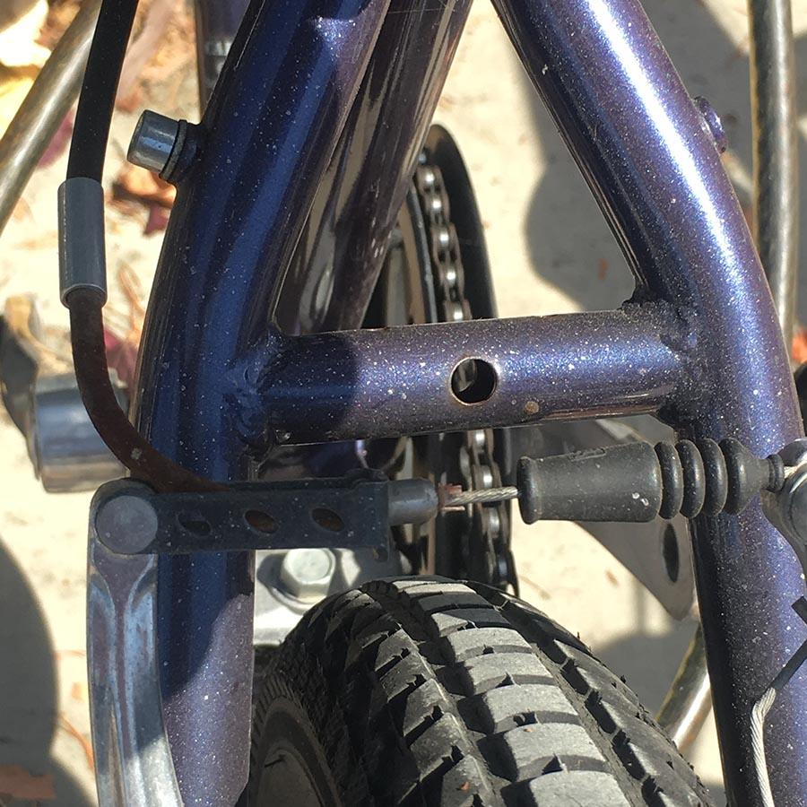
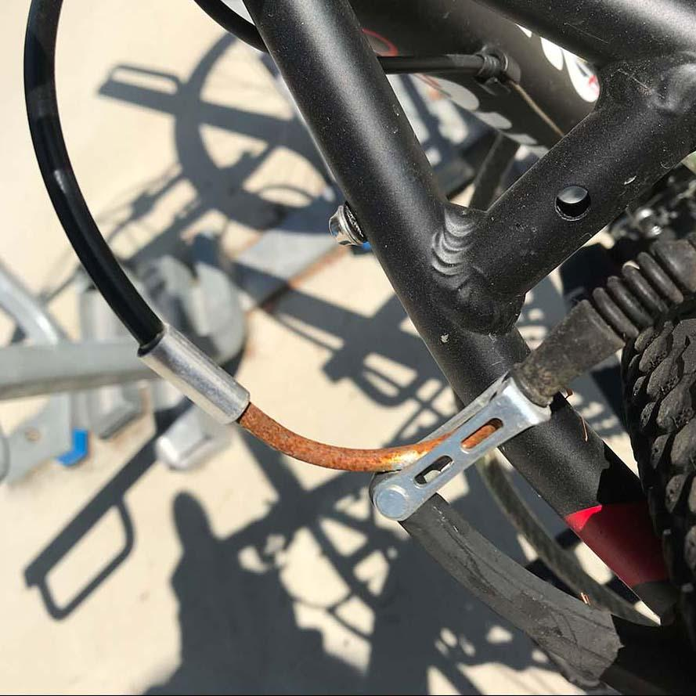
Brake Cable Housing
Bike 8
Bike 9
Bike 10
Bike 70
Bike 72
Bike 72
Notes:
Brake cable housing is also rusted. This is one of the parts that is the more tedious to replace.

Slide 10
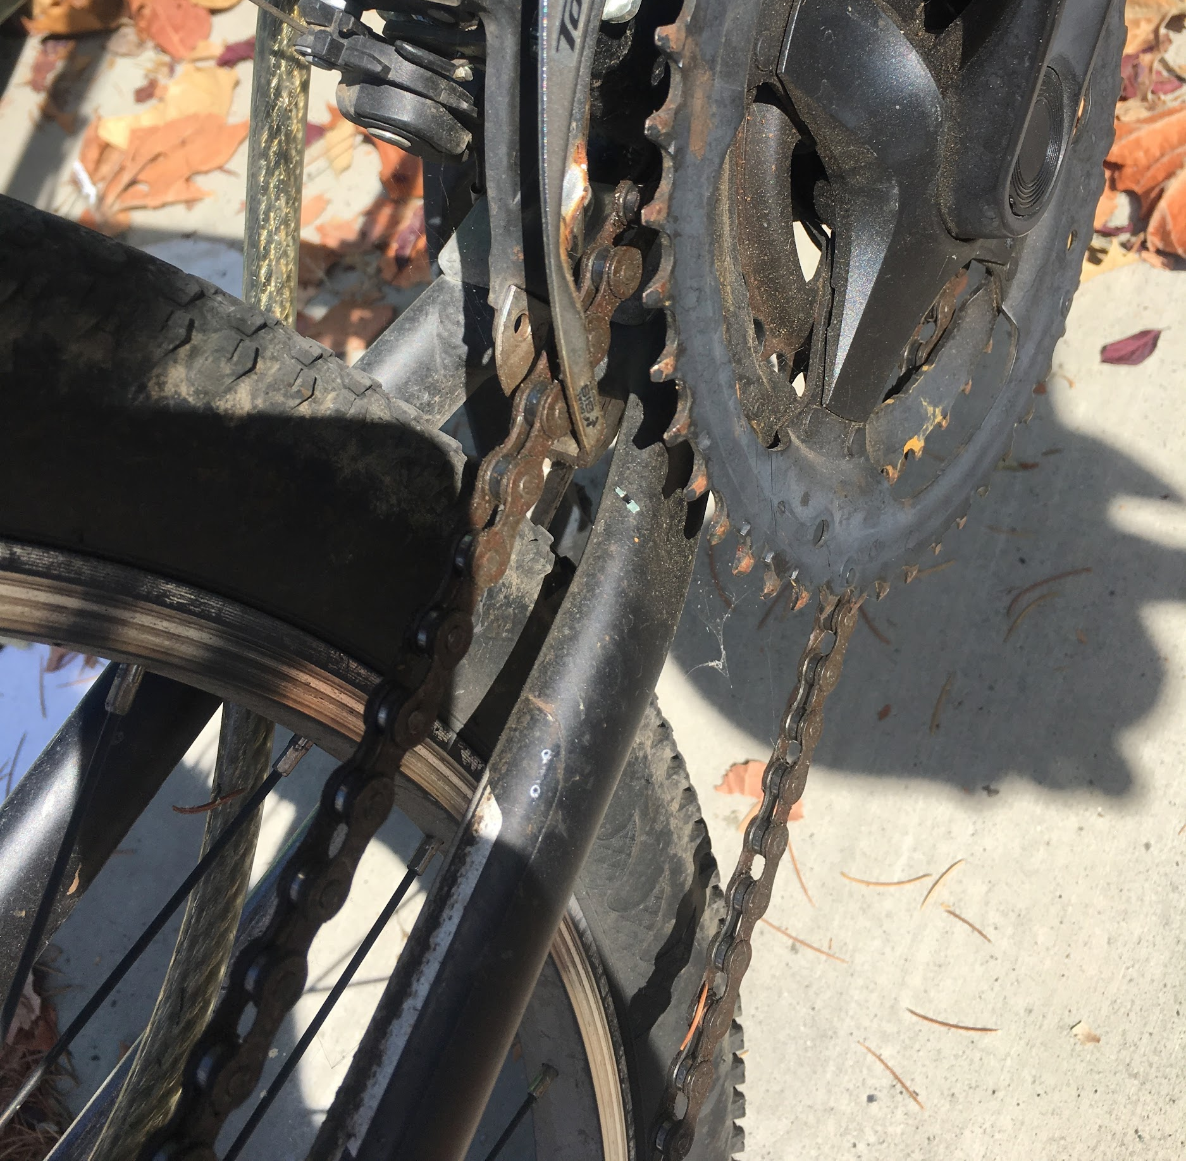
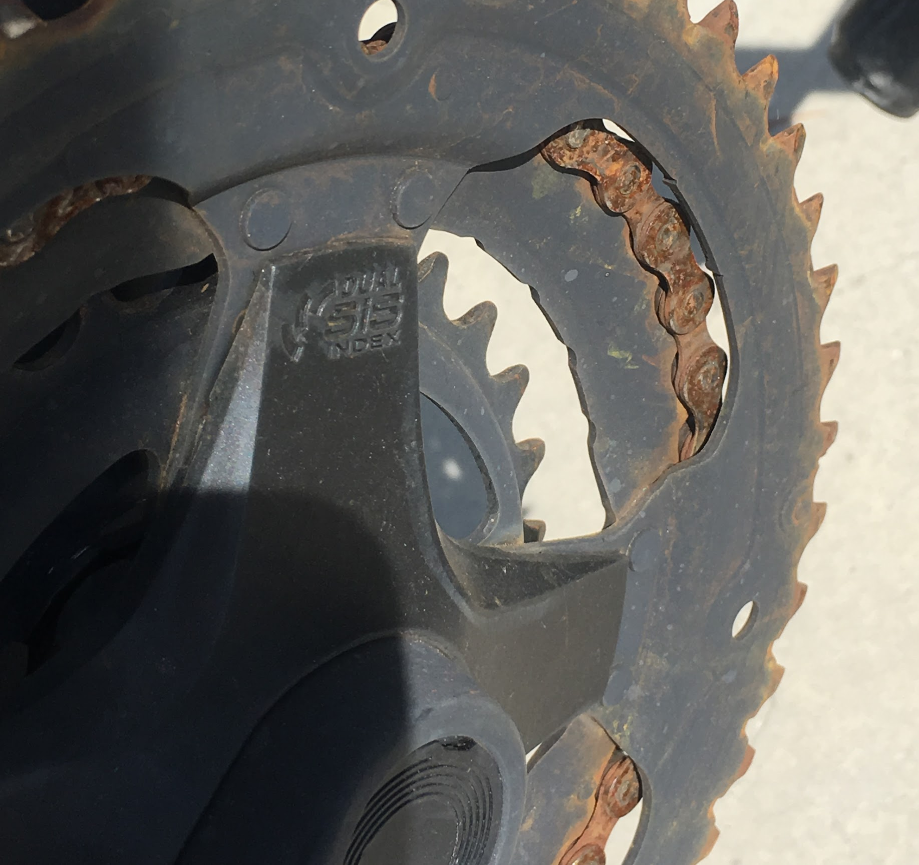
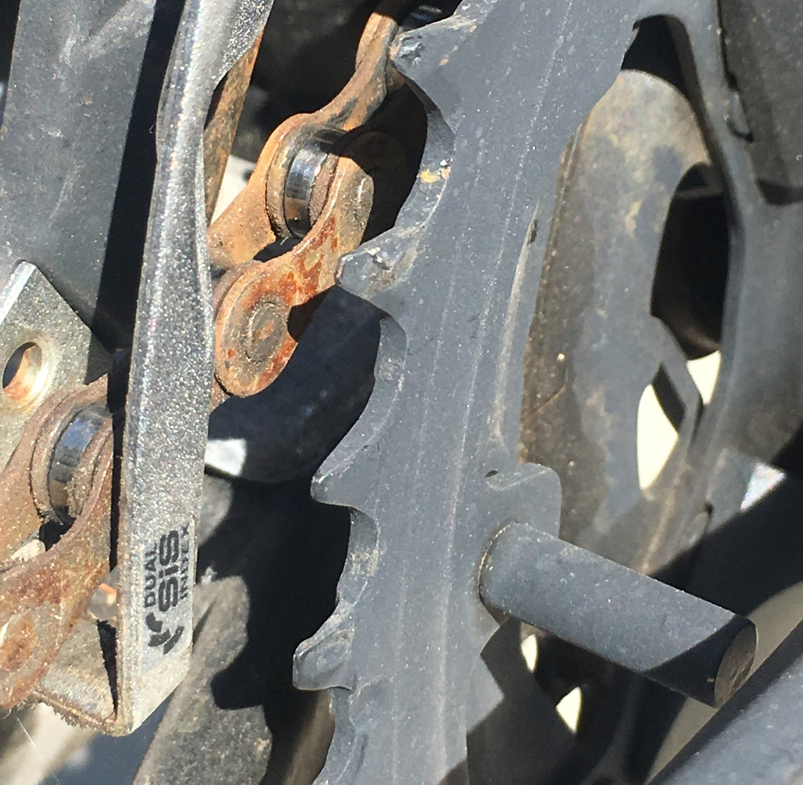
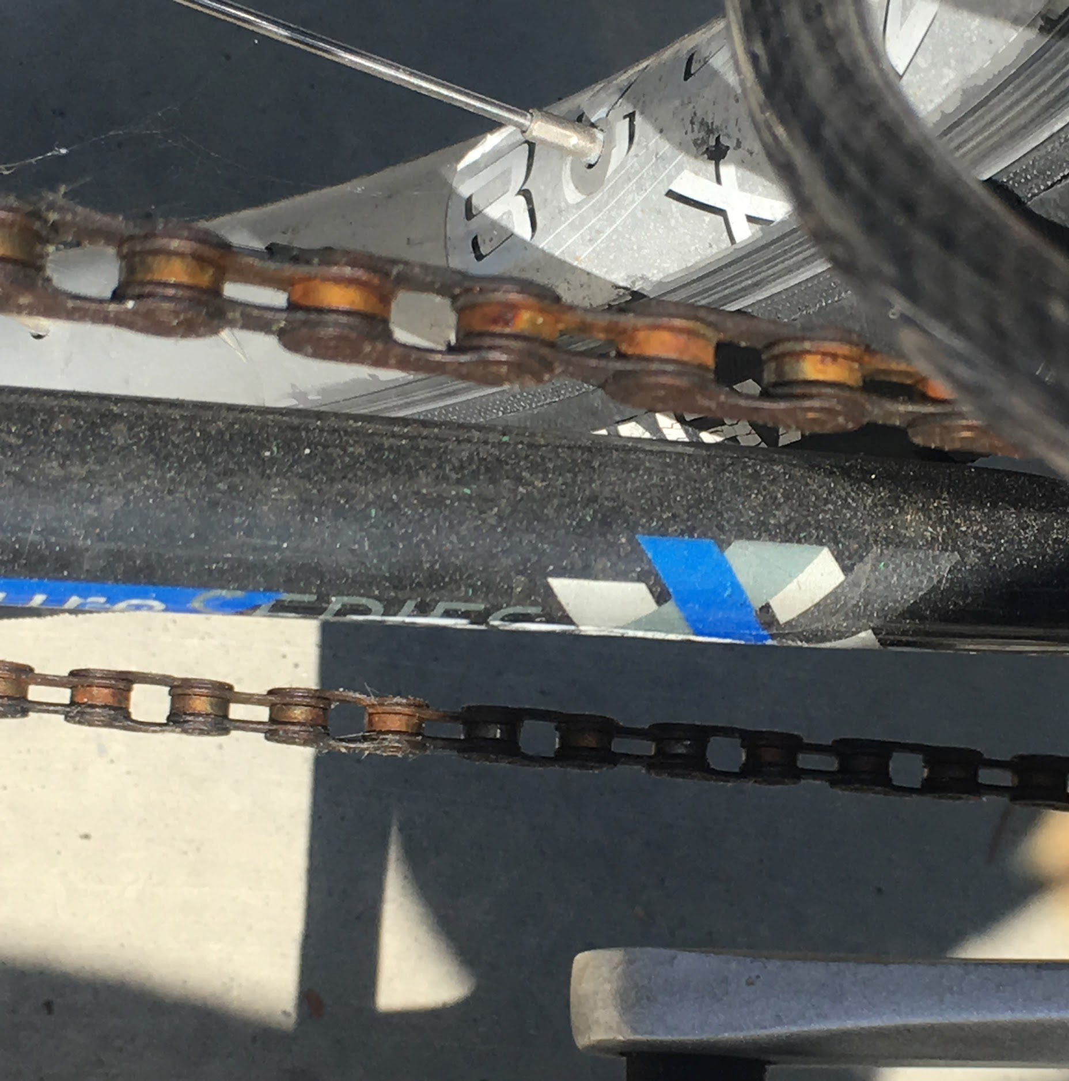
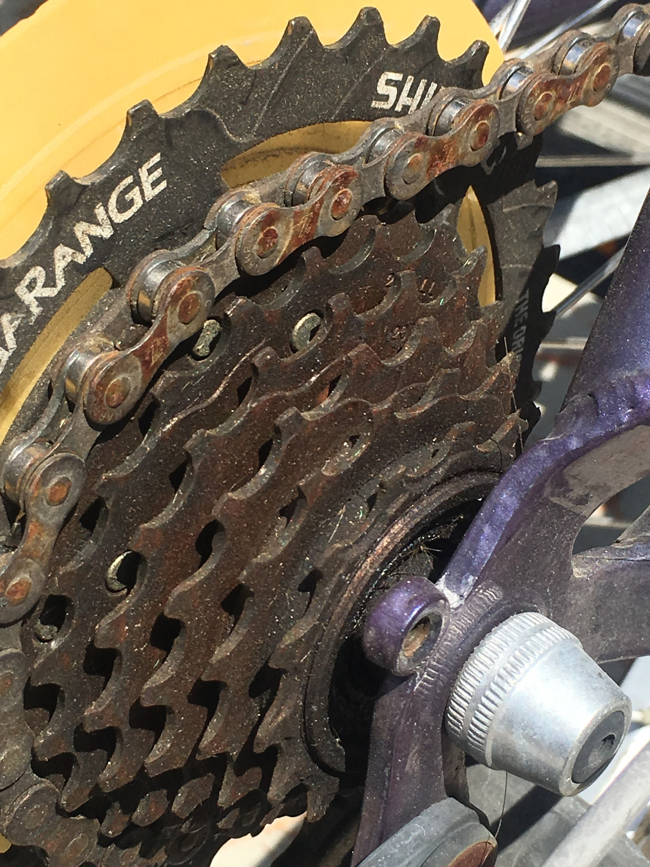
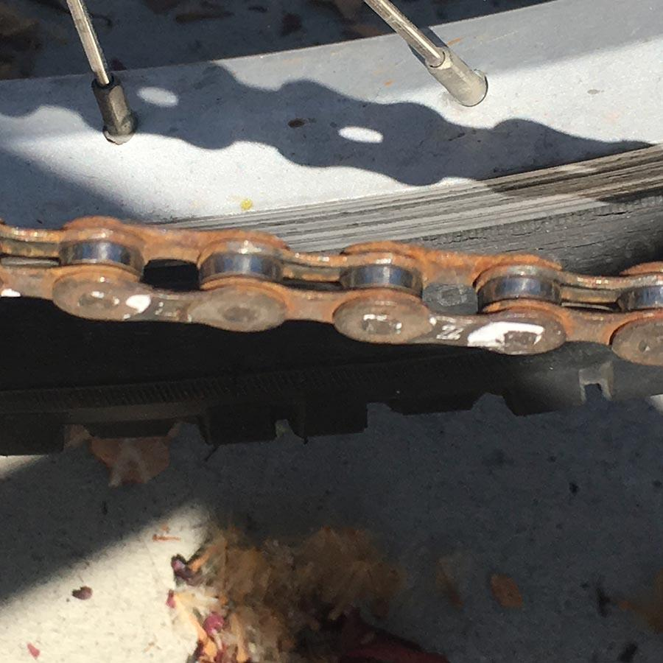
Chains
Bike 111
Bike 110
Bike 101
Bike 92
Bike 75
Bike 55
Notes:
Most essential part of the bike. Easy to replace, but expensive.
Left unprotected, needs to be replaced often.
Can’t operate bike if the links are frozen by rust.
Minimum 1 week to show signs of rust if left outside.

Slide 11
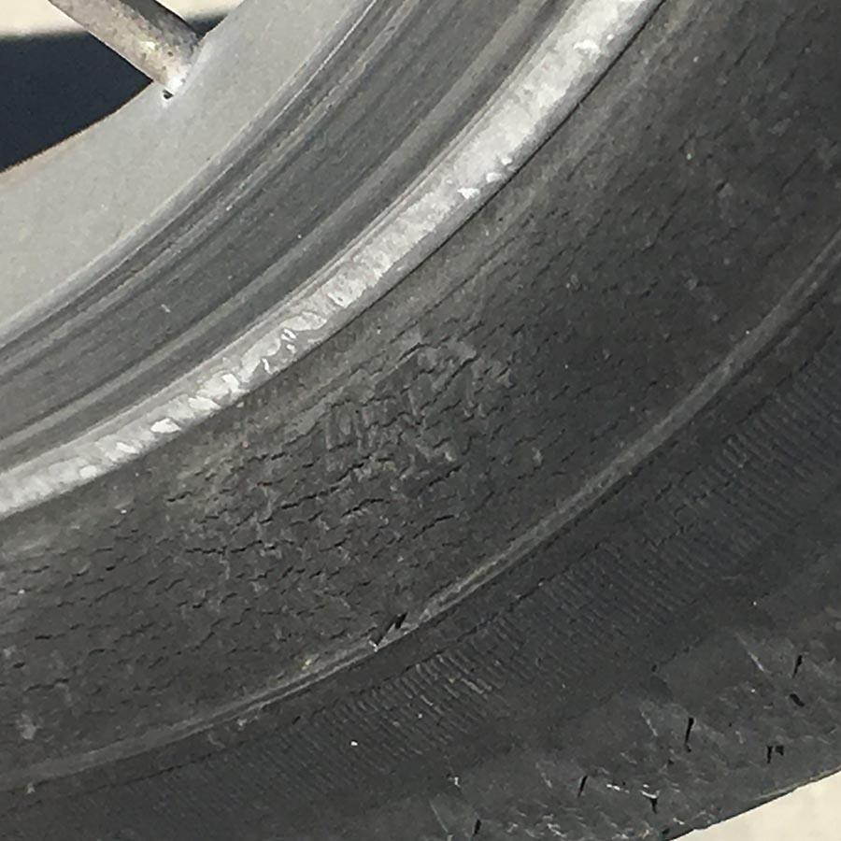
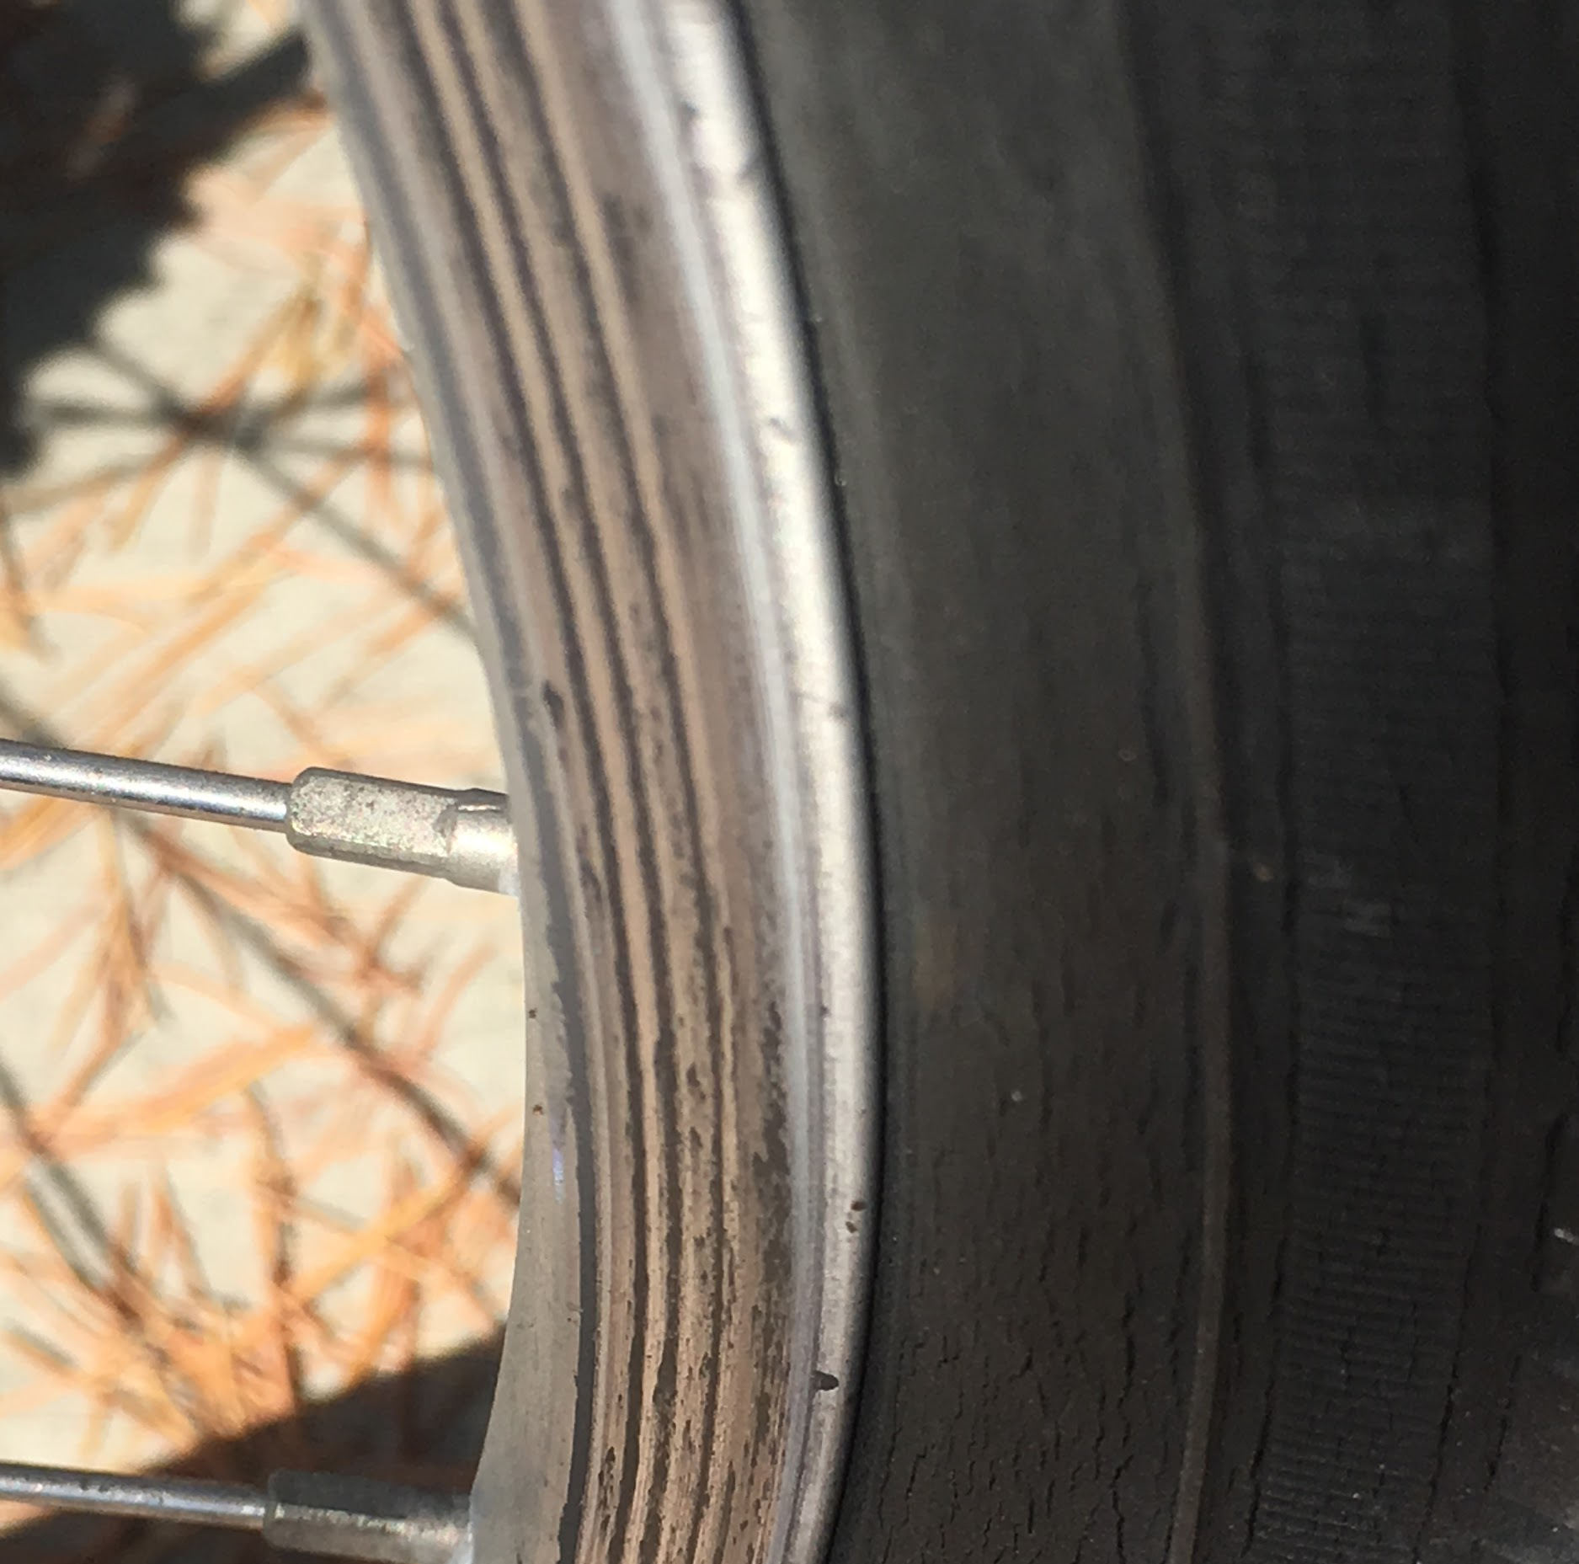
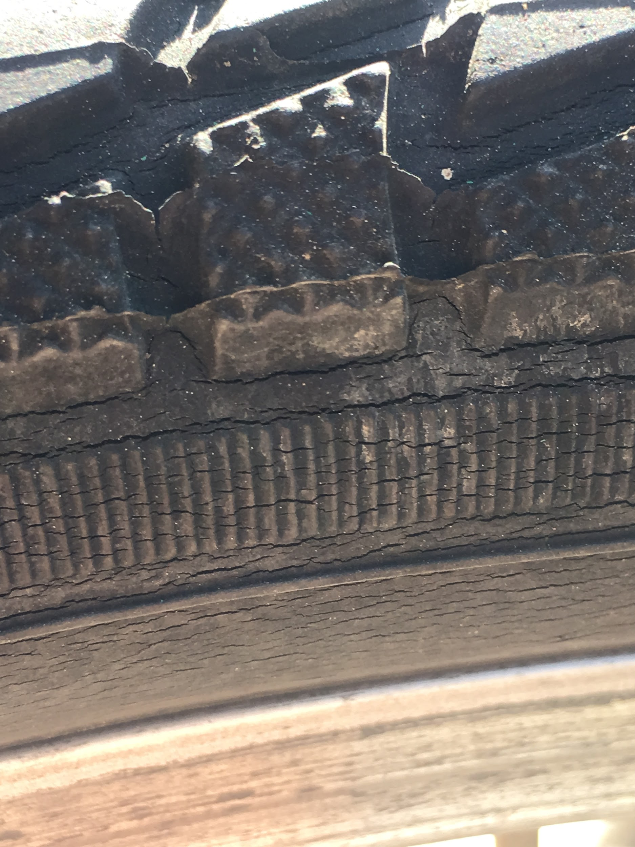
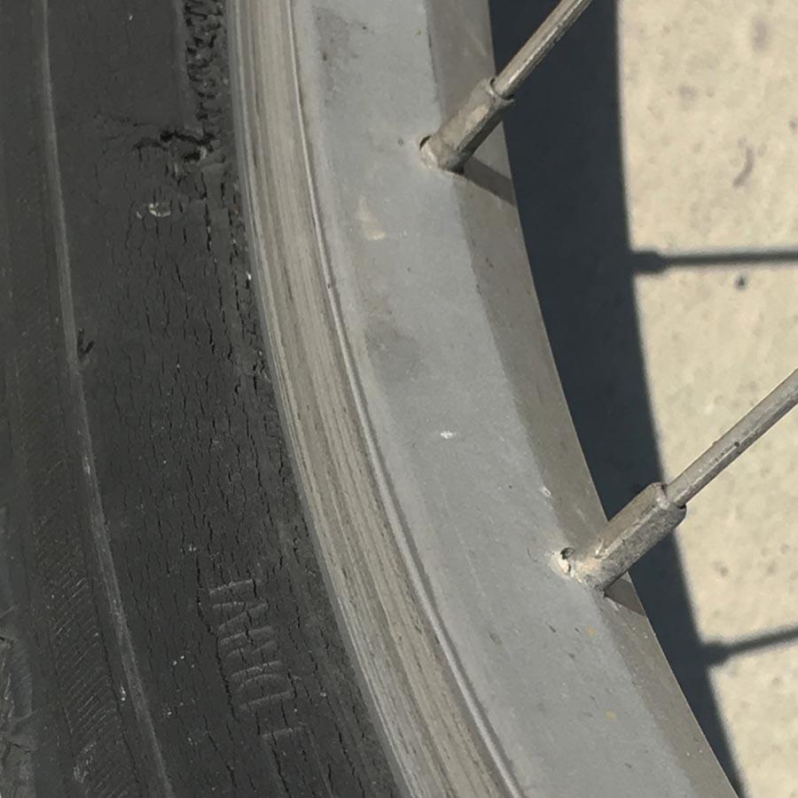
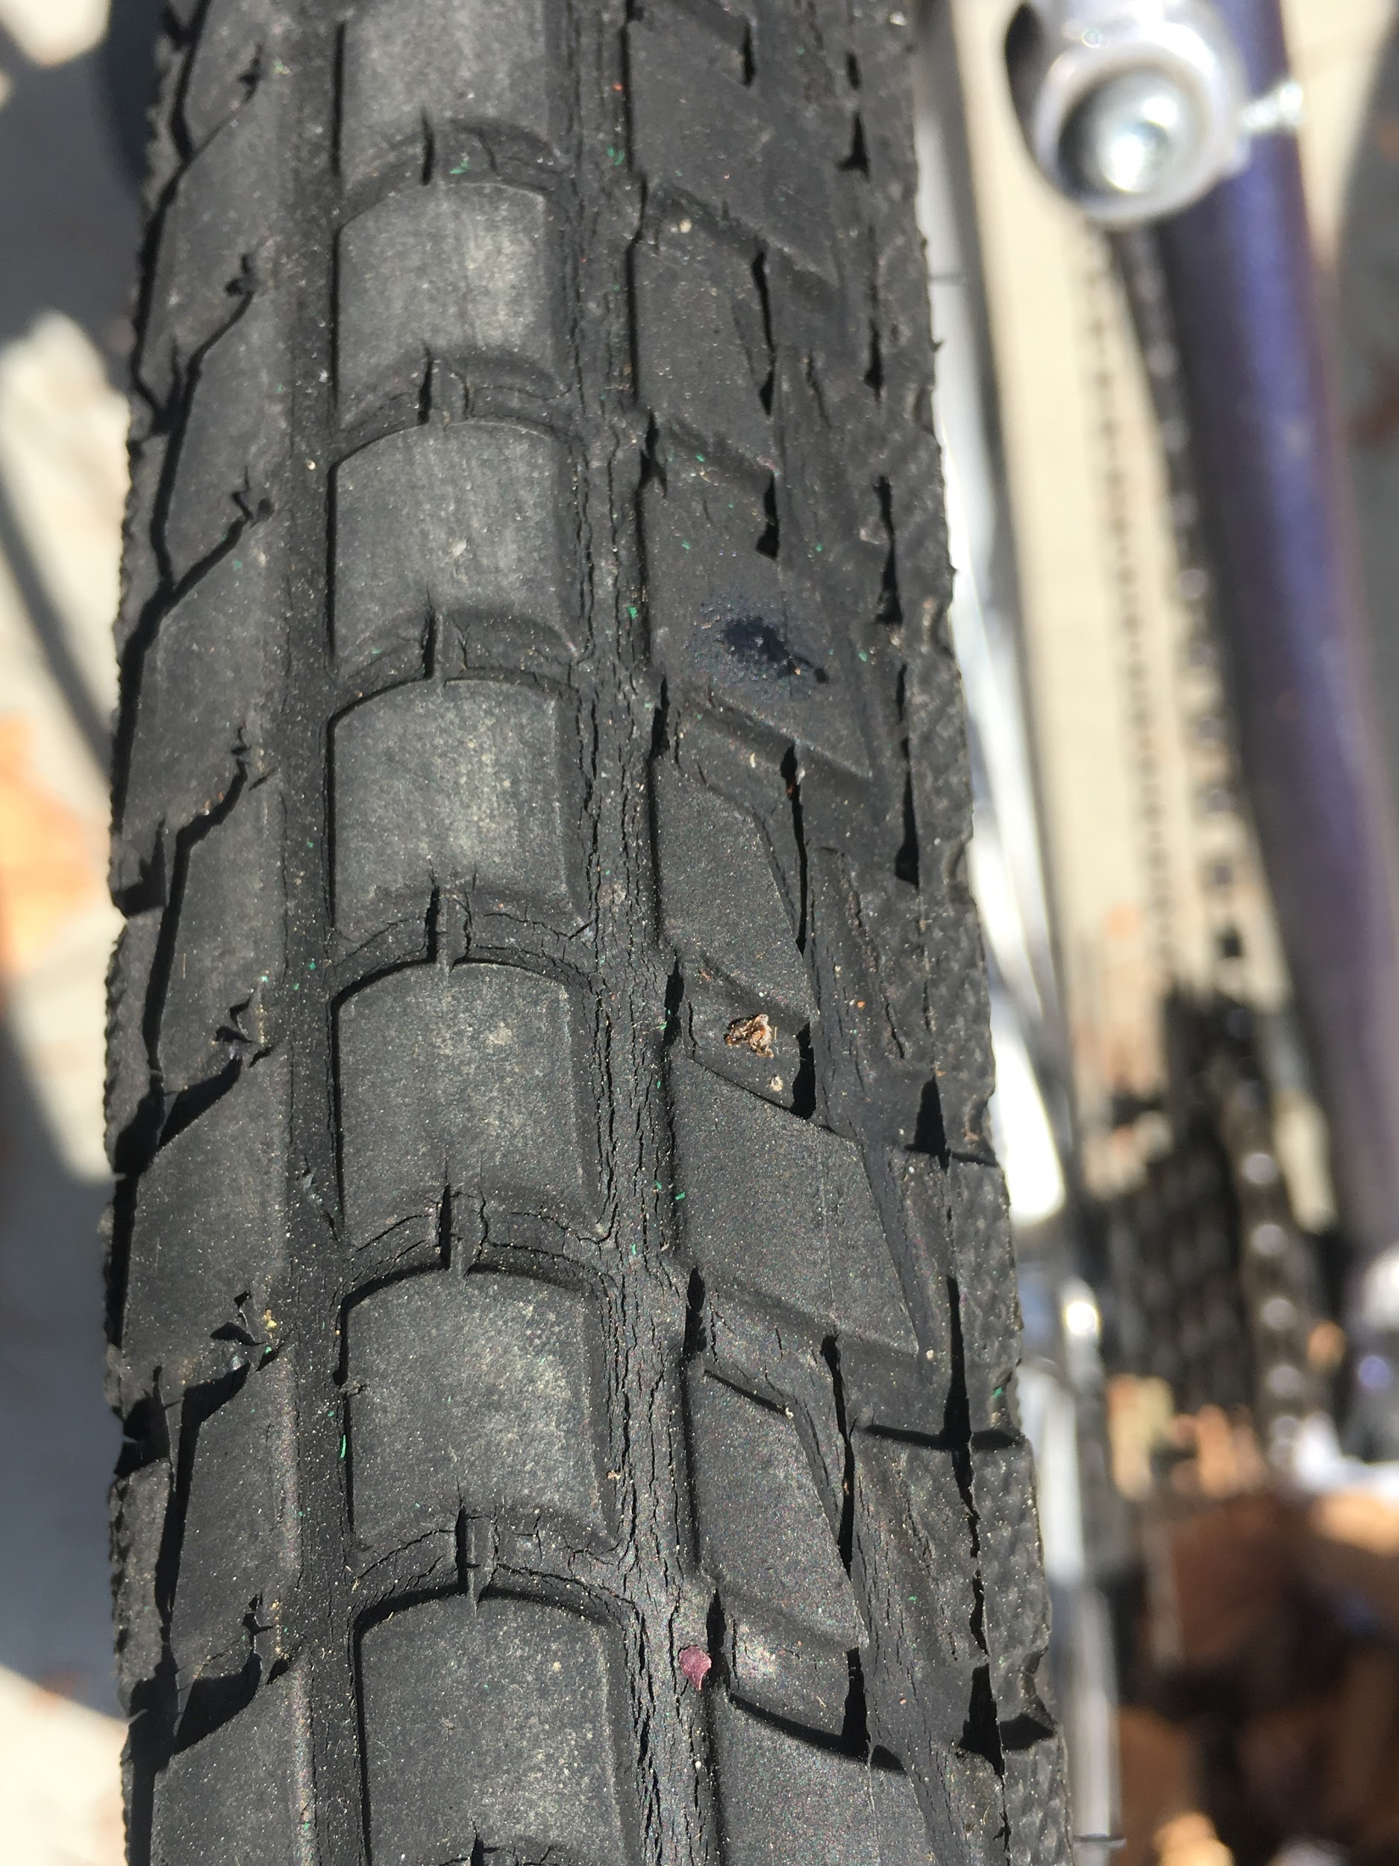
Tires
Bike 55
Bike 64
Bike 89
Bike 80
Bike 62
Bike 74
Notes:
It’s difficult to see, but there are cracks in the tires pictured here.
Cracks caused by long-term UV exposure
Debris can get caught in cracks, causing tires to be susceptible to flat tires.

Slide 12
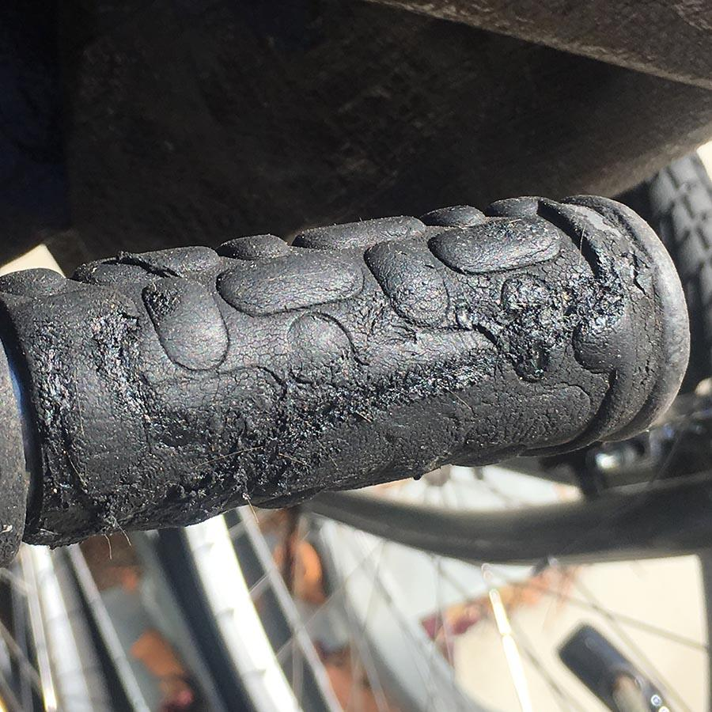
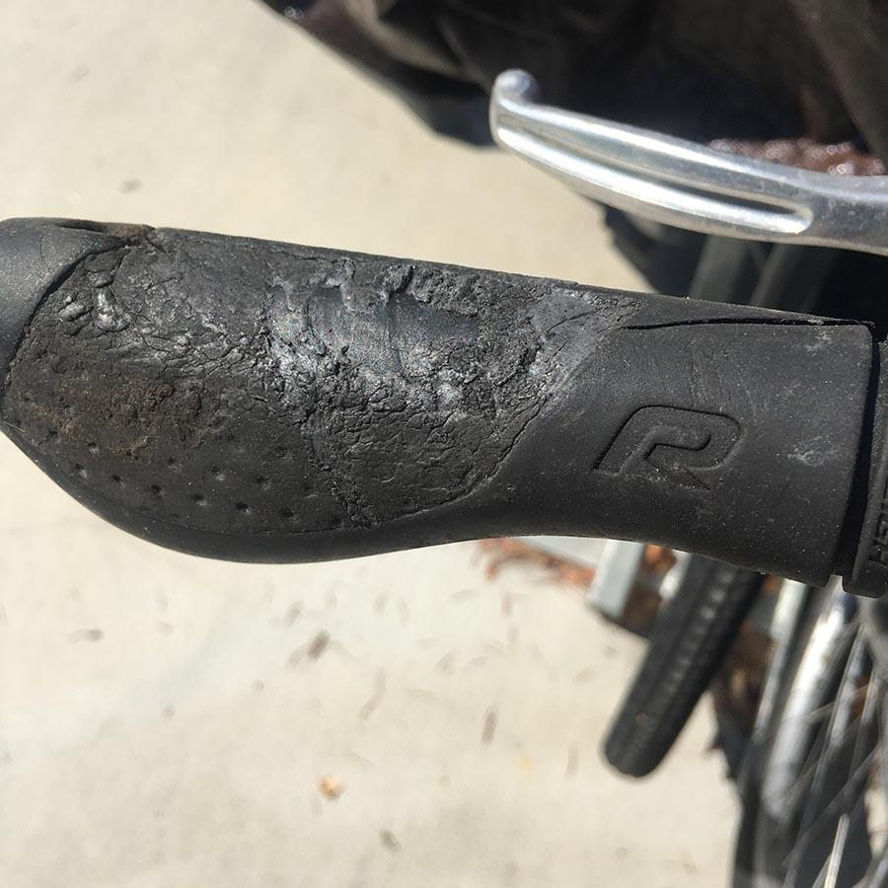
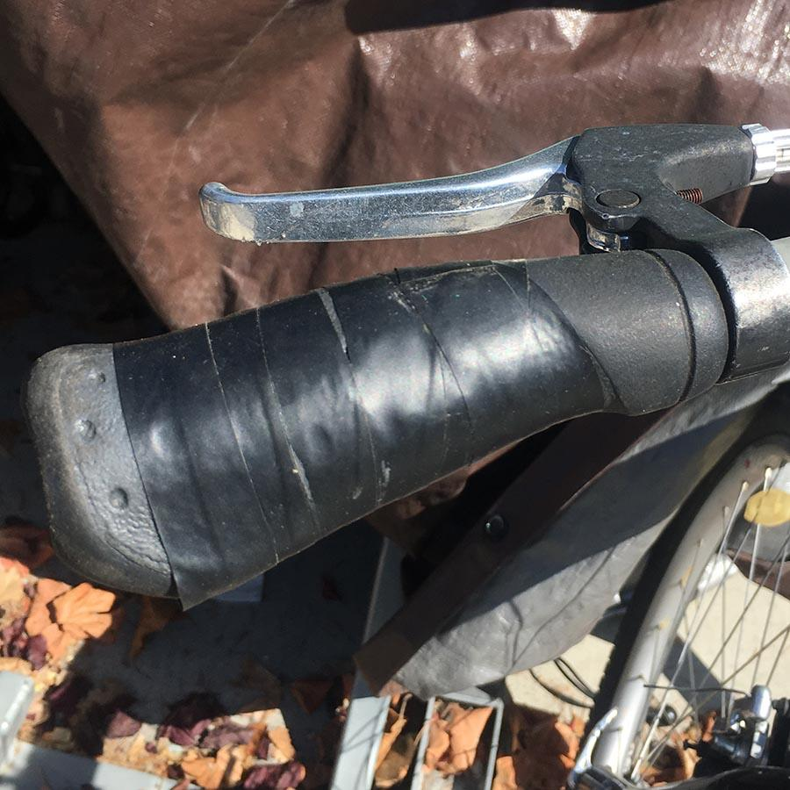
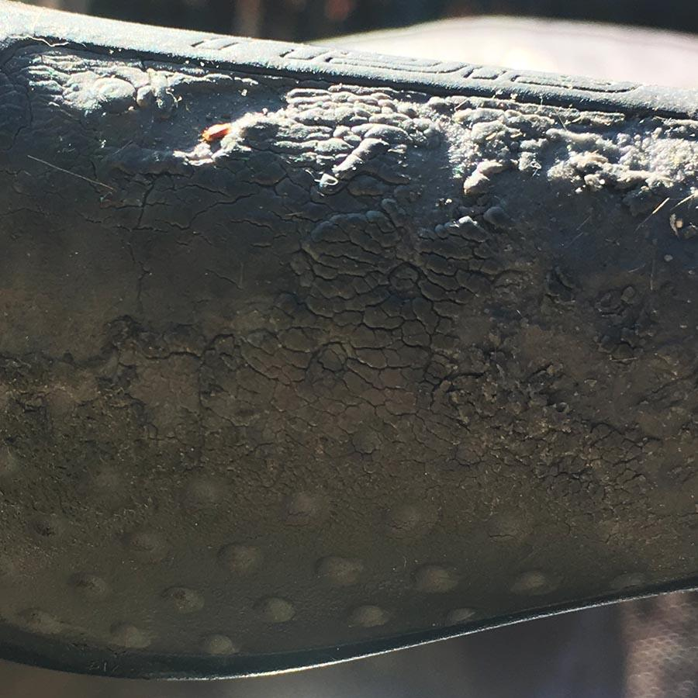
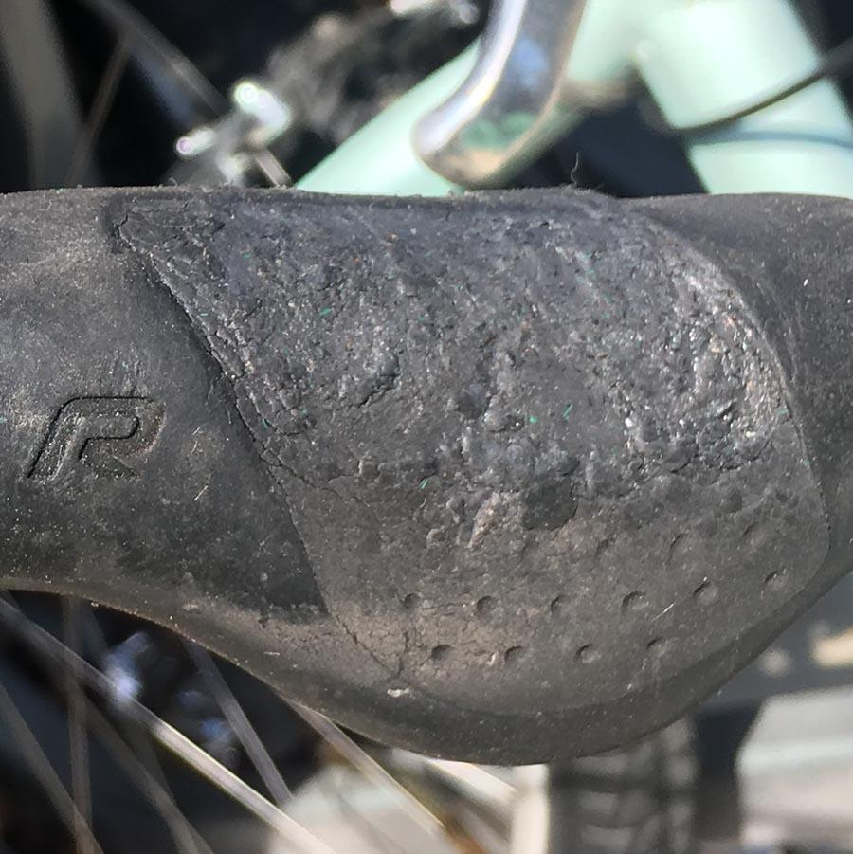
Handlebar Grips
Bike 3
Bike 57
Bike 69
Bike 6
Bike 10
Bike 17
Notes:
Imagine you’re getting ready to go to school. You sit on your bike and get ready to ride, but you can’t take your hands off the handlebars. They are glued on.
Handlebar material disintegrates in the same way as the tires and seats do. The only difference is the material becomes sticky.
Bike #6: The handlebars are so bad, we use tape. This is a short term solution. Tape falls off easily.

Slide 13
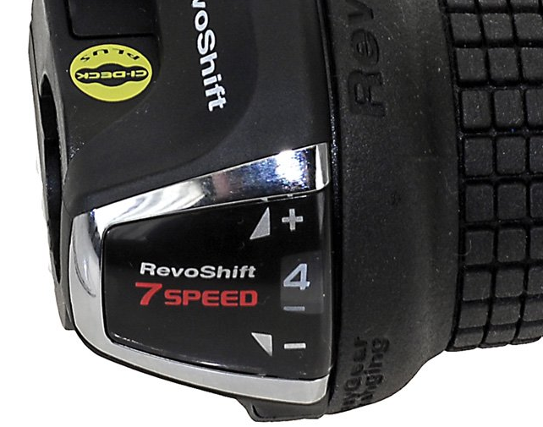
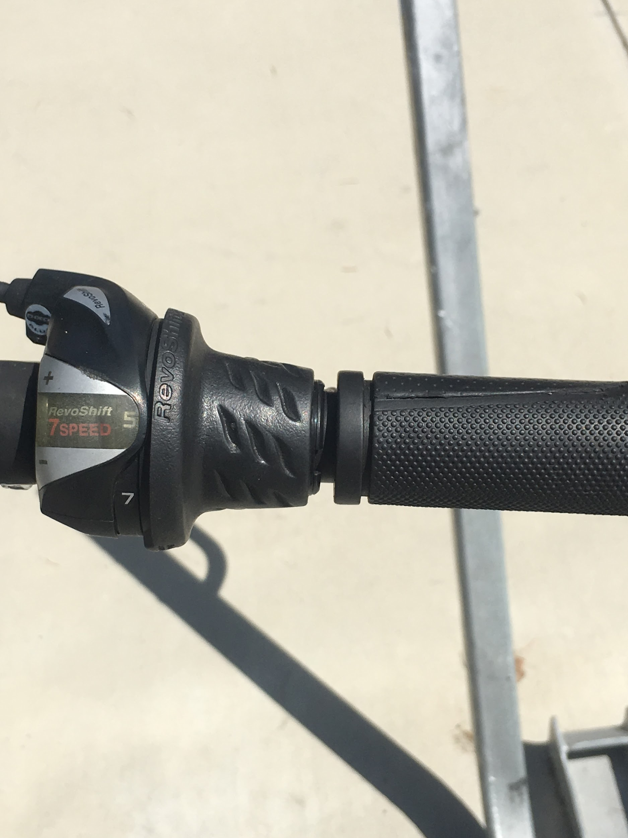
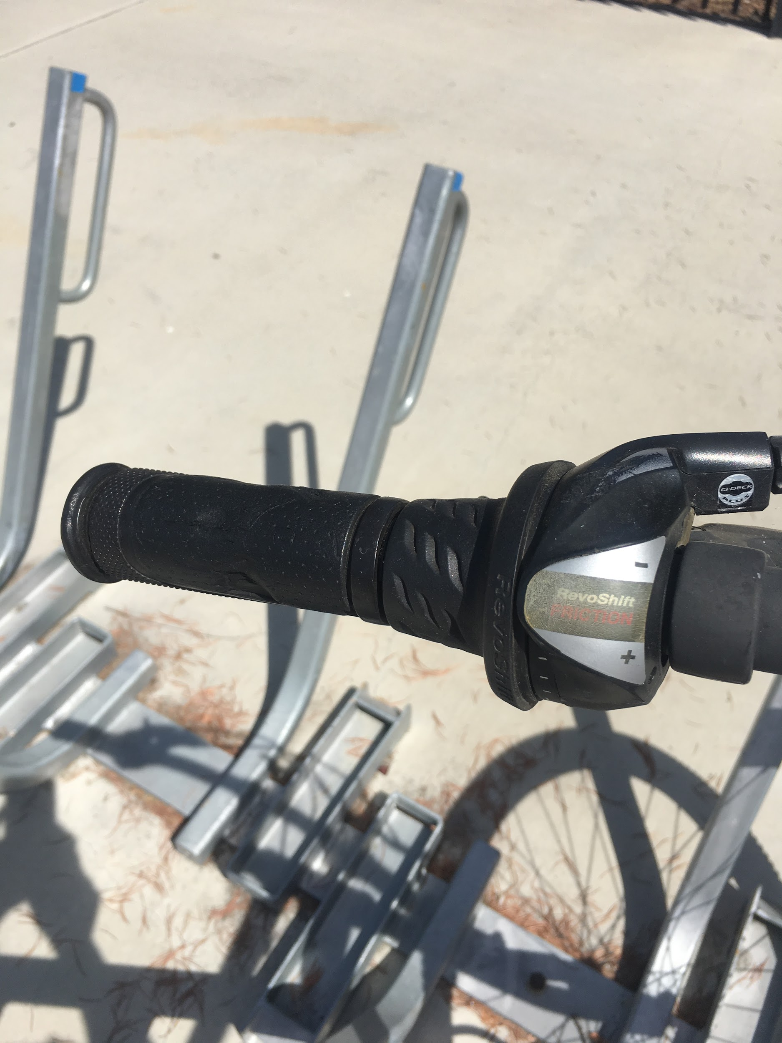
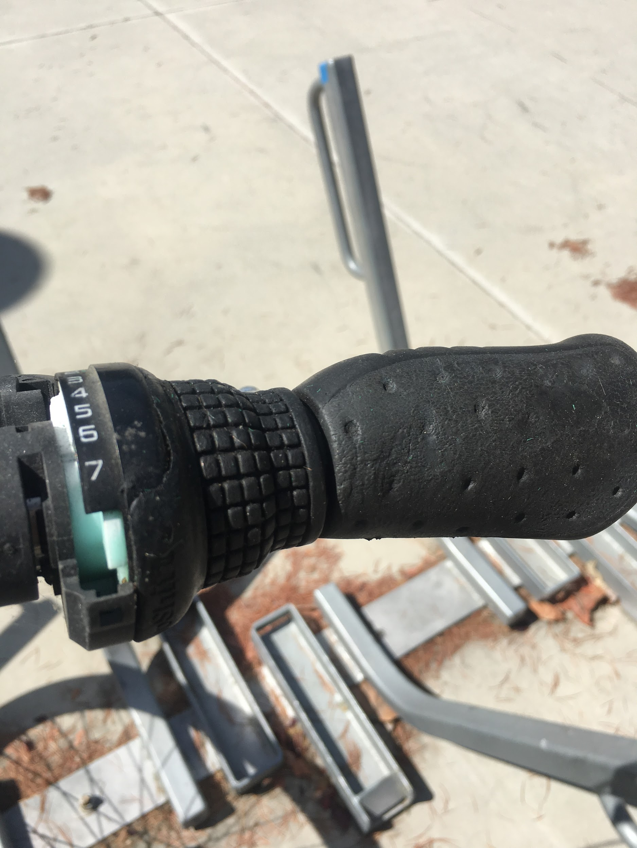
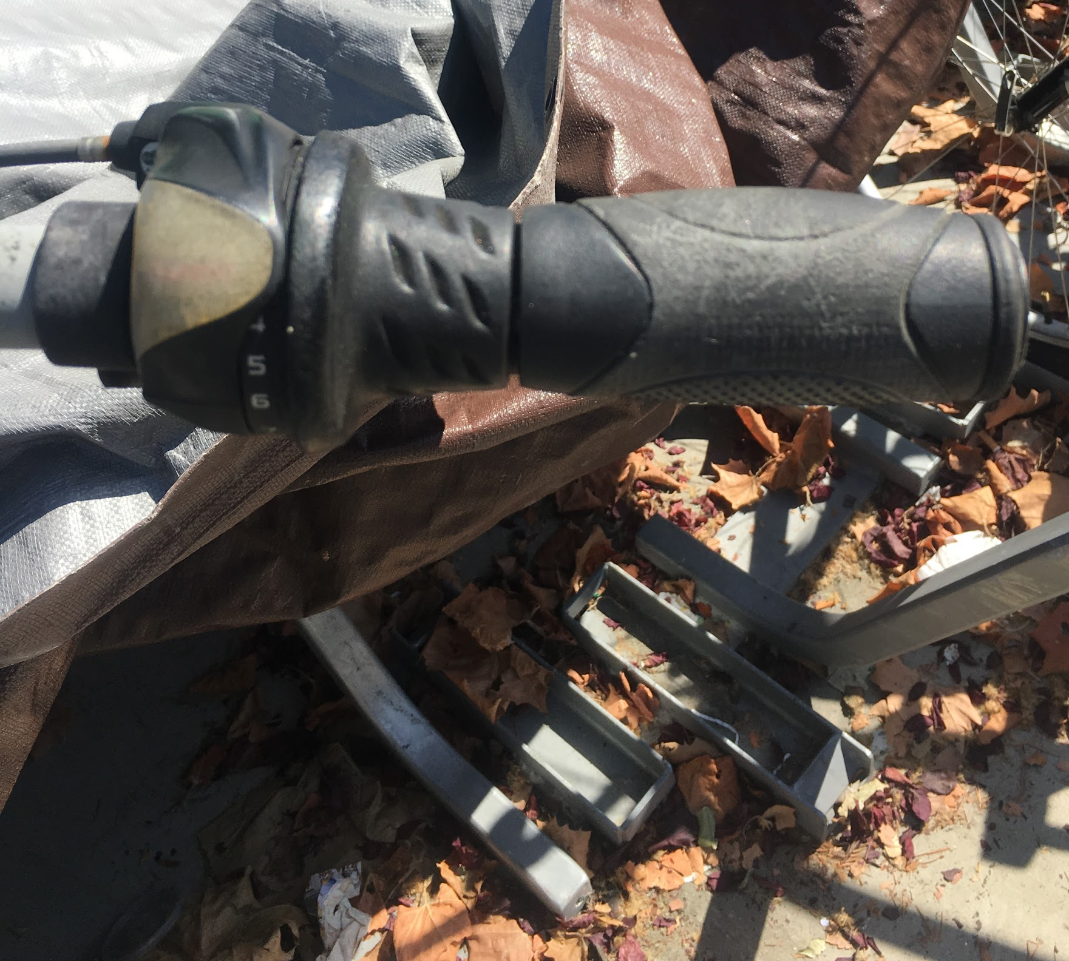
Gear Shifter
Bike 12
Bike 102
Bike 110
Bike 76
Bike 99
Bike 18
Notes:
Can you see the numbers on the gear shifter?
This is how they are supposed to look.
This is another example of UV damage; discoloration and cracking.

Slide 14
Bikes’ Lifespan Cut Short
Bikes are outside, unprotected from the sun and the rain.
1 week to show signs of rust and visible damage.
Using tarps as the solution is not ideal.
Break down over time
Trap in moisture, trapping heat
Bob Cormia (Calabazas Cyclery): lifespan of each part significantly reduced when left outside;
Tires: 2 years
Handlebar grips: 1 year
Chains, freewheel/cassette and chainrings: 1 winter/rainy season
Brakes: 1 rainy season
Seats: 2 years
Notes:
As you could tell from the slides before, all of our bikes are in the corral with no protection overhead.
We do have a short term solution, as you can see here in the picture, the tarp also breaks down in the sunlight too. Moisture also is trapped between tarp and handlebars and contributes to handlebar rust you saw earlier.
I spoke with our bike mechanic and he said if bikes are left outside without a structure overhead, this is how often we need to replace different parts.

Slide 15
Breakdown of Costs
Item | Price** | Replacement Frequency | Total Cost after 2 years
Handlebar grips | $15.99 | 1 year | $1918.80
Seats | $34.99 | 2 years | $2099.40
Chains | $49.98 | 1 rainy season | $5997.60
Tires | $43.99 | 2 years | $2639.40
60 bikes x Part x Replacement Frequency = Total Cost
Total Cost of Replacements: $12,655.20
**Prices based on the most recent purchase of supplies made on June 28th, 2019.
✞ According to our mechanic from Calabazas Cyclery
Notes:
So based on the recommendations from our bike mechanic, We went over all of the damages of the bikes, and these are the costs of the parts that we have to replace. Over the span of two years, it would cost 12k. We want to emphasize this because these are costs that can be saved if we have a structure over the bikes because it preserves the bikes for the long term.
Just to keep this in perspective, these are costs we can prevent and save on if we had a structure over the corral. We would have to replace the items less frequently.

Slide 16
Bike Program Budget
Program was allocated $700 to spend on supplies.
Most of these costs cover modest wear and tear on bikes.
Notes:
Last year senate approved the budget of $700 for supplies.
This budget is reserved for emergency repairs or lost items
we cannot afford to replace parts on every bike.
700 is not enough for one year if we continue without a structure overhead.

Slide 17
Summary: Structure needed.
Financially: The bike program is an asset to students that should be maintained and well-kept. We need to preserve the budget and eliminate frequent repairs.
Sustainability: Replacing bike parts frequently is not environmentally sustainable. (High turnover of individual bike parts).
Serving Students: Less available bikes means we cannot efficiently serve our student population. Bikes that need frequent repairs and parts means less available bikes for students to rent.
**Weaker bike program: Loss of transportation security for students.
Notes:
To conclude: If we had a structure, we would;
Use our funds efficiently as intended
Not have to contribute to environmental destruction.
Assist our student population with transportation security
Stronger bike program
The reason why we bring this forward is because this is not something the Office of College Life or DASB can fix. We need the support of Campus Facilities to help fund this initiative.

Slide 18
Sources
RUST
“Q & A: Effects of Rust.” Q & A: Effects of Rust | Department of Physics | University of Illinois at Urbana-Champaign, https://van.physics.illinois.edu/qa/listing.php?id=494.
Gillespie, Claire. “How Does Salt Water Rust Metals?” Sciencing, 2 Mar. 2019, https://sciencing.com/salt-water-rust-metals-5150093.html.
Corrosion and the Environment, https://www.lehigh.edu/~amb4/wbi/kwardlow/corrosion.html
UV LIGHT
“How UV Can Harm Your Materials.” AFP, 10 June 2019, https://americanflexible.com/uv-can-harm-materials/.
“Ultraviolet Effects: UV Resistance: Material Functionality: Knowledge: Huddersfield Textiles.” Ultraviolet Effects | UV Resistance | Material Functionality | Knowledge | Huddersfield Textiles, http://www.tikp.co.uk/knowledge/material-functionality/uv-resistance/the-effects-of-ultraviolet-light-on-polymeric-materials/.
Yousif, Emad, and Raghad Haddad. “Photodegradation and Photostabilization of Polymers, Especially Polystyrene: Review.” SpringerPlus, Springer International Publishing, 23 Aug. 2013, https://www.ncbi.nlm.nih.gov/pmc/articles/PMC4320144/.
BIKE EXPERTISE
Bob Cormia - Calabazas Cyclery | 6140 Bollinger Rd, San Jose, CA 95129
Notes:
Questions?

